Slide 1
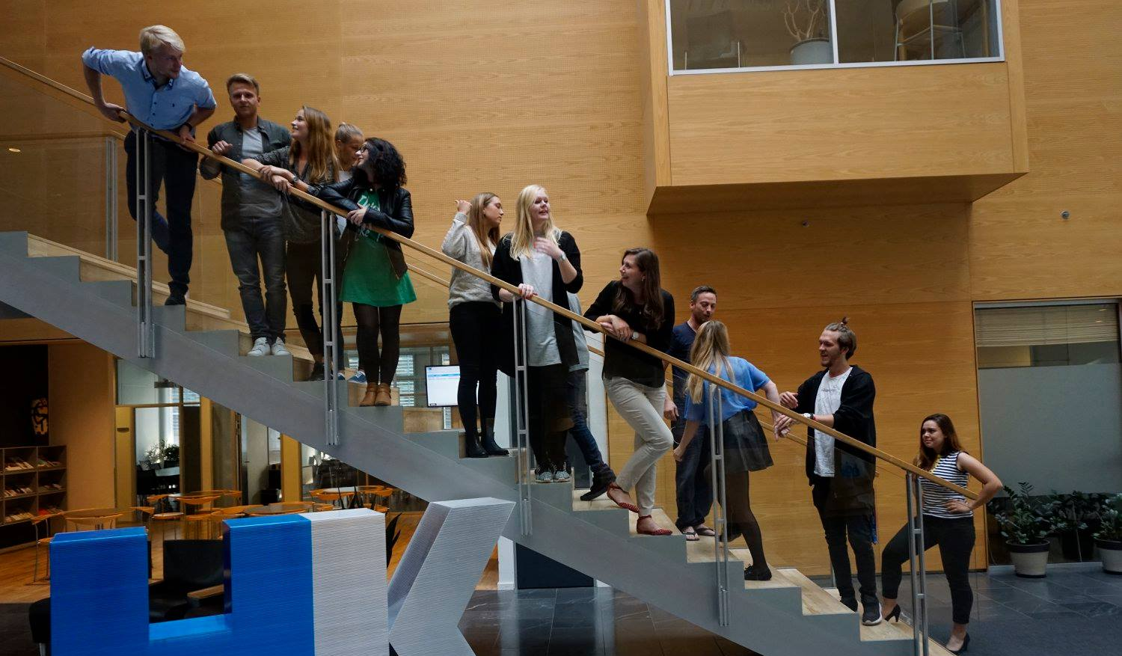
49th Board meeting
Cphbusiness Students
05.04.2022

Slide 2
AGENDA
Approval of the agenda
Choice of minutes taker
Approval of the minutes (previous meeting)
Orientation from the chairmanship
Financial situation / Treasurer
Budget for the next year (July to June)
Orientation from the student representatives in the Cphbusiness’ board of directors
Re-organisation of the student involvement at Cphbusiness / Charlotte
Other topics
Next meeting

Slide 3
1. Approval of the agenda

Slide 4
2. Choice of minutes taker

Slide 5
3. Approval of the minutes from the 48th board meeting

Slide 6
4. Orientation from the chairmanship
Volunteer status
DESO orientation and our stand on collaboration with unions.
Communication needs improvement – courses?
Activities executed Spring 2022:
Information meeting in February
Open house
Action Day (still going)

Slide 7
4. Orientation from the chairmanship
Activity Wheel – rest of Spring 2022:
April: HK conference
May: “Exam Kickoff” with course in Time Management. Collaboration with HK.
24th June: Semester party with pre-dinner event for volunteers (part of the Restart Project)

Slide 8
5. Financial situation
Balance on the bank account:
+197.423,45 DK
Current bank account access: Nicoline
Dinero is cancelled

Slide 9
6. Budget for next year

Slide 10
7. Orientation from the student representatives
First meeting
Questions?

Slide 11
8. Re-organisation of the student involvement

Slide 12
9. Other topics

Slide 13
9. Next board meeting
50th Board Meeting
16 August 2022

