Slide 1
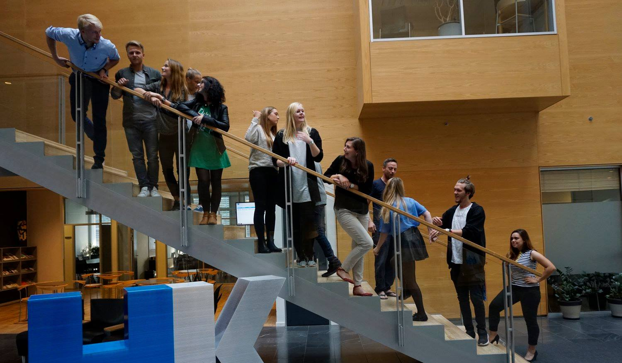
46th Board meeting
Cphbusiness Students
06.09.2021

Slide 2
Agenda
Approval of the agenda
Choice of minutes taker
Approval of the minutes (previous meeting)
Status on the board
Orientation from the chairmanship
Status on volunteers
Status on managers of the functions
Status on collaboration with business partners (e.g., HK, Cphbusiness Alumni, Sportyfied)
Annual General Meeting
Financial situation / Treasurer
Balance on the bank account
Financial report from the previous year (July to June) (to be presented at the AGM)
Budget for the volunteer introduction meeting
Orientation from the student representatives in the Cphbusiness’ board of directors
Activities in the semester
Other topics:
Steps against closing down international educations (visiting student will lead the discussion)
Process with merch and volunteers t-shirts
Steps against closing international educations
Process with Students Cphbusiness merch (+volunteers merch)
Goodwill board member
LinkedIn page
Next meeting

Slide 3
1. Approval of the agenda

Slide 4
2. Choice of minutes taker

Slide 5
3. Approval of the minutes from the 45th board meeting

Slide 6
4. Status on the board
Board members:
Angel Manuel Fernandez Alcantara (chairman)
Jana Bubáková (vice-chairman)
Nicoline Ravn Grønbech (treasurer)
Charlotte Dalgaard, Cphbusiness (secretary)
BM 4?
BM 5?
Alternates:
Jasmin Florence Bachmann
Josefine Düring Reyes Jensen
Ewa Smykla
Left the board:
Jamie Marie Schmidt
Monika Gailiute

Slide 7
5. Chairmanship orientation
Status on volunteers:
Active volunteers: 7
Recruiting activities in process
Status on managers of the functions:
Head of Finance: Nicoline Ravn Grønbech
Head of Events: Jasmin Florence Bachmann
Head of Student Politics: Angel Manuel Fernandez Alcantara
Head of Communication: ? (candidate: Ewa Smykla)
Head of HR: ? (candidate: Josefine Düring Reyes Jensen)

Slide 8
5. Chairmanship orientation
Collaboration with BPs:
HK
Finansforbundet
Cphbusiness Alumni
Sportyfied (webshop: https://cphstudents.sportyfied.com/da)
Student discount (Moodle: https://cphbusiness.mrooms.net/course/view.php?id=203#section-7)
ESN Erasmus Student Network:https://esn.org/
Steel House Hostel
Swapfiets
Bassa Lyngby restaurant

Slide 9
6. AGM date
Suggestion: November 22th

Slide 10
7. Financial situation
Balance on the bank account: 164.398,19 DKK
Annual report is presented by Nicoline

Slide 11
8. Orientation from the student representatives
Meeting dates
Chairmanship invitation, Line

Slide 12
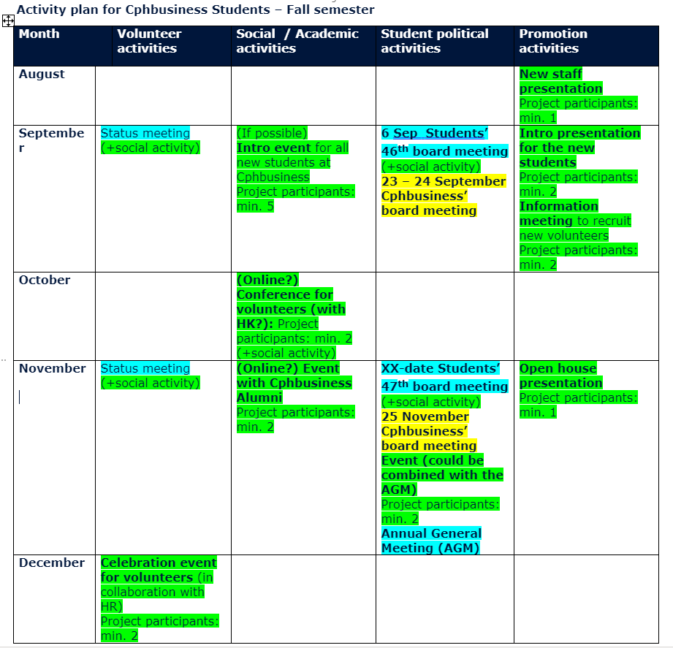
9. Next semester, activity wheel

Slide 13
9. Next semester, activity wheel
Dates:
Volunteer introduction meeting
16th & 30th of September
HK event for volunteers
6th & 7th of October

Slide 14
10. Other topics

Slide 15
10. Other topics – Goodwill Board
Keep contributing for Cphbusiness
External view
Keep Building Partnership
International Oriented
Cphbusiness Bridge Maker
Provide help and give insights of past experience in the board and student life.

Slide 16
11. Next board meeting:
47th Board Meeting
Suggestion: 29th of November 2021

