Slide 1
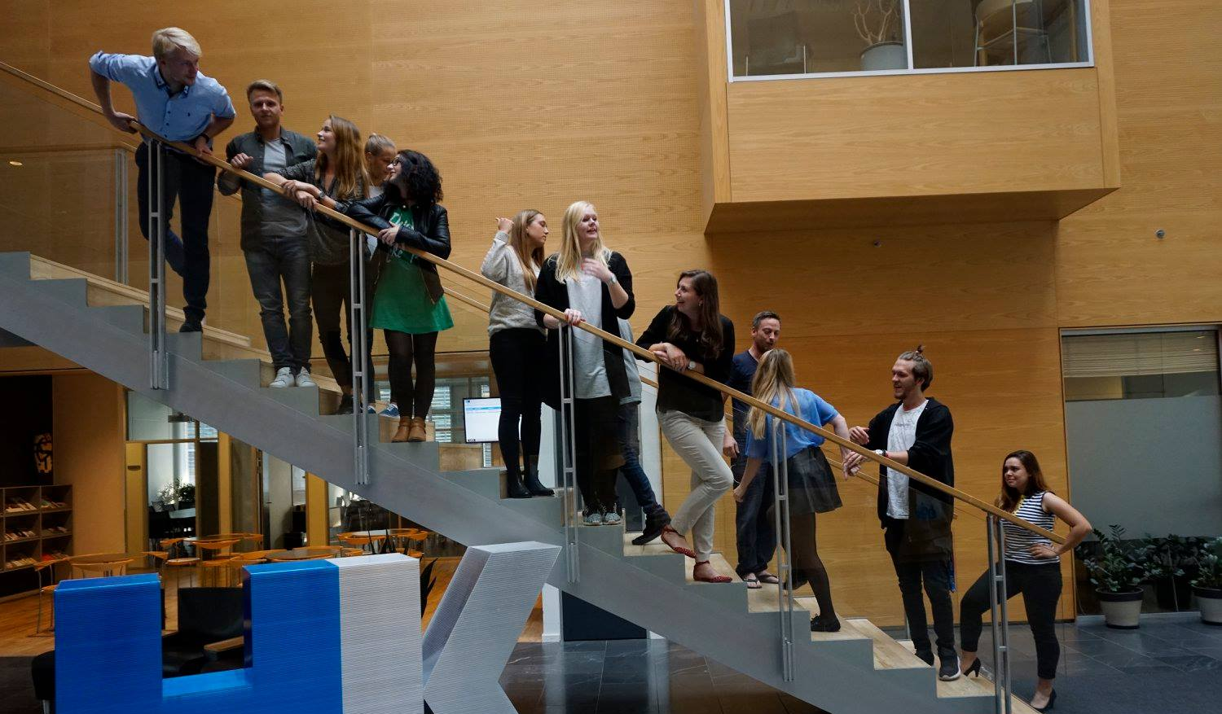
45th Board meeting
Cphbusiness Students
26.04.2021

Slide 2
Agenda
Approval of the agenda
Choice of minutes taker
Approval of the minutes (44th meeting)
Alternates for the board (vote)
Financial situation (Treasurer)
Balance on the bank account
Status on the annual report
Guidelines for money spent on meetings
Orientation from the chairmanship
Status on volunteers
Status on managers of the functions
Activity wheel for the next semester
Orientation from the student representatives
Other topics
Next meeting

Slide 3
1. Approval of the agenda

Slide 4
2. Choice of minutes taker

Slide 5
3. Approval of the minutes from the 44th board meeting

Slide 6
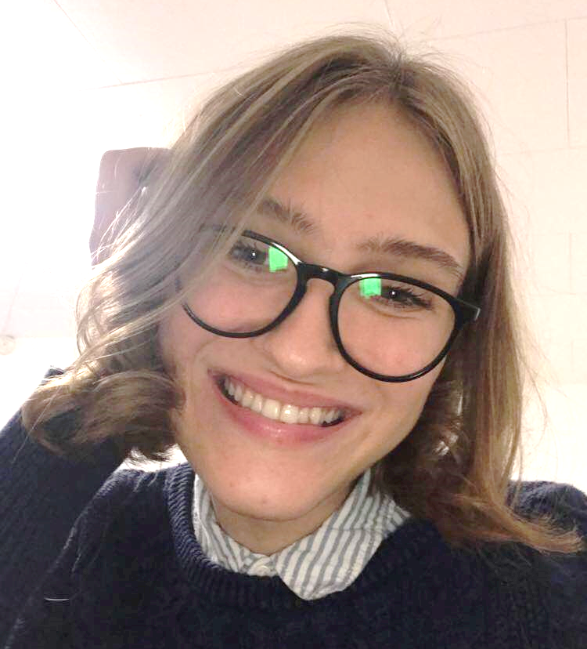
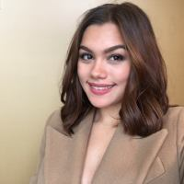
4. Alternates for the board
Candidates for alternates:
Josefine Düring Reyes Jensen
Ewa Smykla
Jasmin Florence Cadavero Bachmann

Slide 7
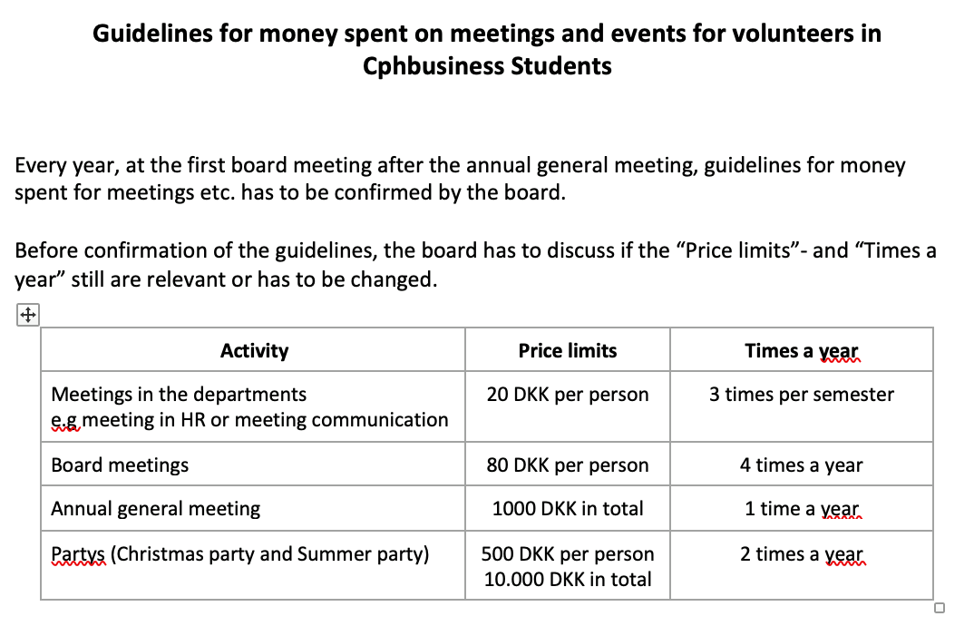
5. Financial situation
Balance on the bank account: 164.601,64 DKK

Slide 8
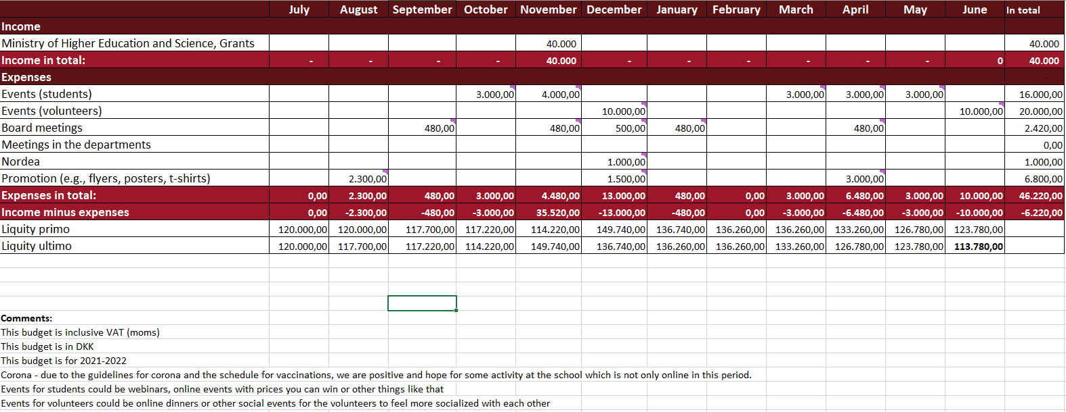
5. Financial situation - Budget

Slide 9
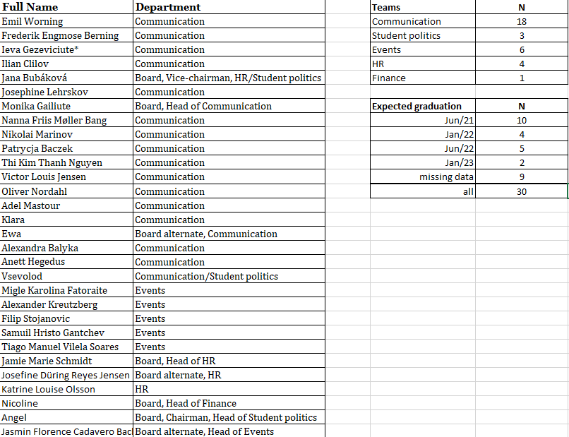
6. Chairmanship orientation
Status on volunteers

Slide 10
6. Chairmanship orientation
Status on managers of the functions
Communications – Monika
Events – Jasmin
HR – Jamie
Finance – Nicoline
Student politics - Angel

Slide 11
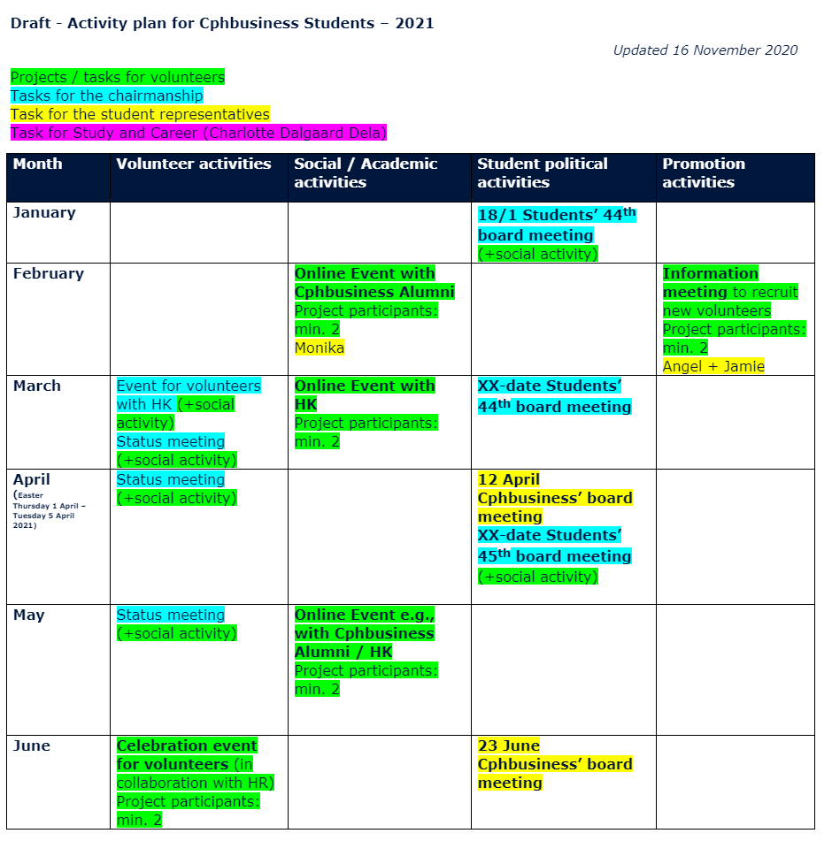
7. Next semester, activity wheel
6th – social event for volunteers

Slide 12
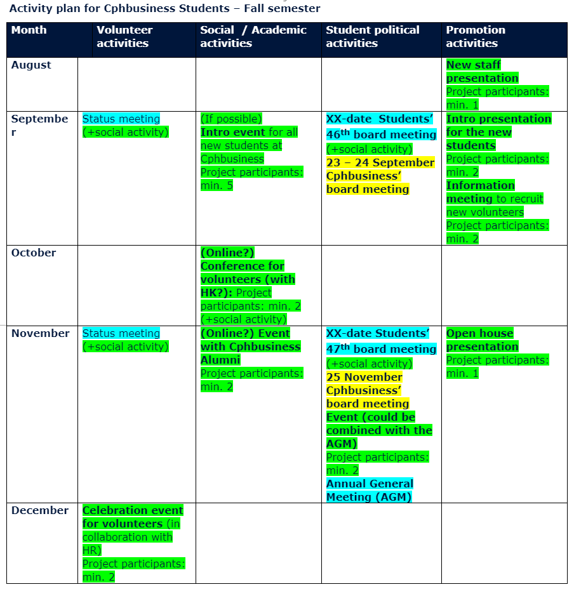
7. Next semester, activity wheel

Slide 13
8. Student repre., orientation

Slide 14
9. Other topics

Slide 15
10. 46th Board Meeting
6th of September 2021

