Slide 1
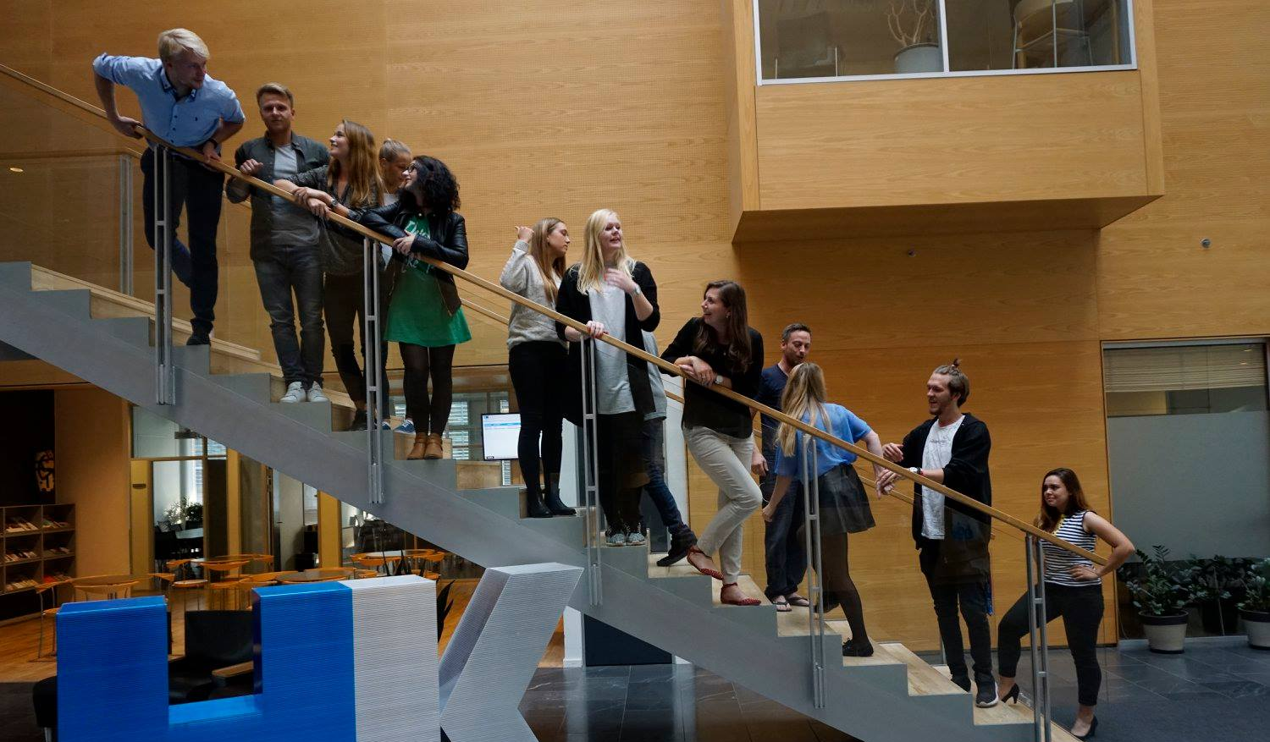
39th Board meeting
Cphbusiness Students
13.02.2020

Slide 2
Agenda
Approval of the agenda
Choice of minutes taker
Approval of the minutes (39th meeting)
Orientation by the chairman
Status on manager roles
Financial situation / Treasurer
Budget
Strategy for the students organization/Charlotte
Activity plan 2020/Charlotte
Other topics
Next meeting: 23 April from 16:45 to 18:15

Slide 3
1. Approval of the agenda

Slide 4
2. Choice of minutes taker

Slide 5
3. Approval of the minutes from the 39th board meeting

Slide 6
4. Orientation
Clean up in the basement
Strategy weekend trip (vote)
New board date in the Fall

Slide 7
5. Status on manager roles
Marketing manager – who?
Project manager for HK event in April – who?
HR manager – who?
Students politcs – who?
Students discount manager – who?
Webshop promotion manager – who?

Slide 8
6. Financial situation
Financial status: bank account balance + the amount is Cphbusiness storing (I have asked Anna)
Bank account access – who?
Grant from Cphbusiness / Charlotte (must be put to a vote)
CVR number / Charlotte

Slide 9
7. Budget 2019/2020
Updated account for 1/7-2019 to 31/1-2020
Updated budget for 1/2-2020 to 30/6-2020 (must be put to a vote)

Slide 10
8. Strategy for the students organisation
Charlotte

Slide 11
9. Activity plan 2020
Charlotte

Slide 12
10. Other topics

Slide 13
11. Next Board meeting

