Slide 1
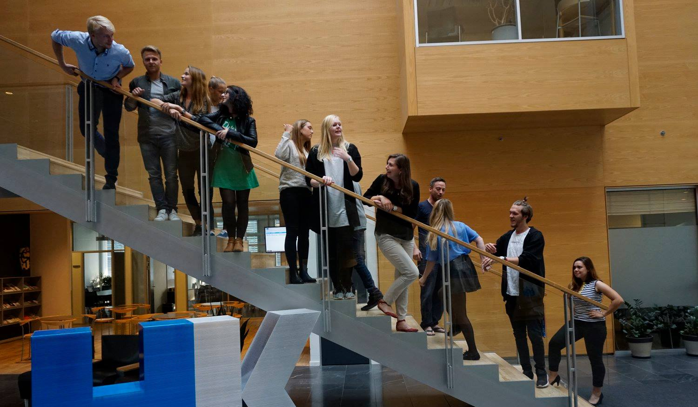
38th Board meeting
Cphbusiness Students
13.01.2020

Slide 2
Agenda
Approval of the agenda
Choice of minutes taker
Approval of the minutes (37th meeting)
Constitution of the board
Responsibilities and activities
Other topics
Next meetings

Slide 3
1. Approval of the agenda

Slide 4
2. Choice of minutes taker

Slide 5
3. Approval of the minutes from the 37th board meeting

Slide 6
4. Constitution of the board
Board members:
Ieva Gezeviciute
Mille Koch Rømer
Isabella Lehim
Oliver Daniel Koch
Arturas Mickevicius
Charlotte Dalgaard, Cphbusiness
Board: 5 members + 3 alternates
Chairman: ?
Vice Chairman: ?
Treasurer: Isabella Lehim
?
?
3 Alternates – no candidates

Slide 7
5. Responsibilities, activities and projects

Slide 8
5. Responsibilities, activities and projects
Responsibilities:
Represent the students at Cphbusiness in Cphbusiness’ board of directors (2 representatives, 4 meetings annually)
Marketing tasks:
Manage the Facebook page
Manage the Instagram profile
Manage the LinkedIn page
Keep the website updated
Tasks at the intro bars and Friday bars during the Spring:
Take pictures at the bars (due to GDPR rules)
Help with promotion of the bars

Slide 9
5. Responsibilities, activities and projects
Responsibilities:
Other:
Recruit and manage the volunteers
Manage the Facebook group “Cphbusiness Students used Study Book Market !” https://www.facebook.com/groups/325992604404207/
Manage the student discounts at Moodle.
Promote the student organisation’s webshop with logo clothes (link: https://cphstudents.sportyfied.com/da)

Slide 10
5. Responsibilities, activities and projects
Activities, Spring 2020:
Events:
Plan and execute an event together with HK in April 2020
Content: social character, not party focus
Co-host at Excel courses with HK. No tasks included.

Slide 11
5. Responsibilities, activities and projects
Projects, Spring 2020:
Study start:
Help the Alumni team developing the study start programme at Cphbusiness:

Slide 12
6. Financial situation
Next steps:
Financial status?
Bank access

Slide 13
7. Other topics?

Slide 14
8. Next Board meetings 2020
– dates?

