Slide 1
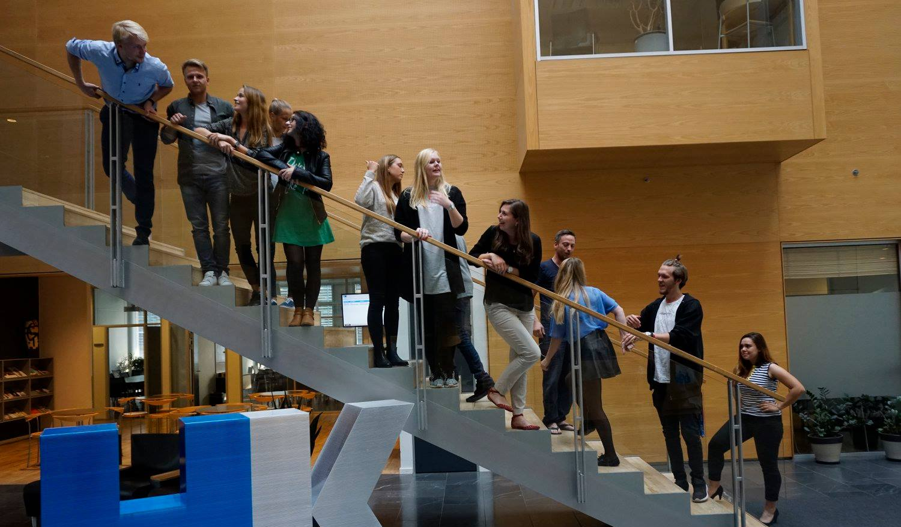
36th Board meeting
Cphbusiness Students
13.11.2019

Slide 2
Agenda
Approval of the agenda
Choice of minutes taker
Approval of the minutes (35th meeting)
AGM agenda and presentation
Friday bar orientation
Next board meeting

Slide 3
1. Approval of the agenda

Slide 4
2. Choice of minutes taker

Slide 5
3. Approval of the minutes from the 35th board meeting

Slide 6
4. AGM agenda and presentation
Boards report
Budget and financial report
Auditors observations of the account
Other suggestions?

Slide 7
5. Friday bar orientation
What is the current situation?
What needs to be done?
How should we de it in the future?
Other comments

Slide 8
7. Next Board meeting

