Slide 1
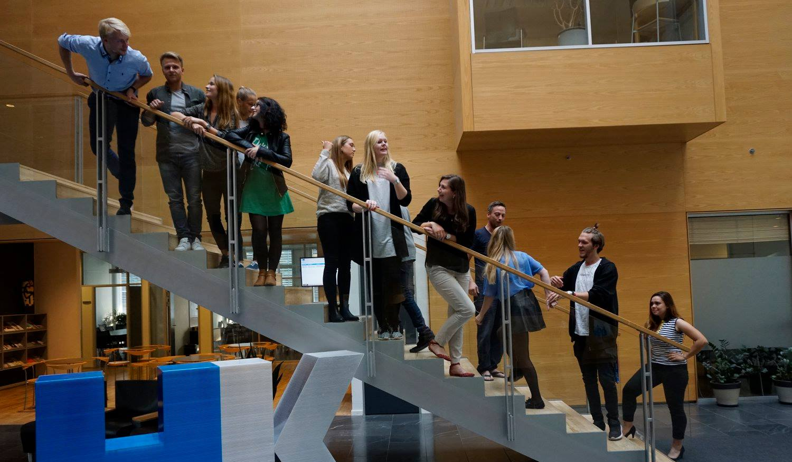
34th Board meeting
Cphbusiness Students
04.09.2019

Slide 2
Agenda
Approval of the agenda
Choice of minutes taker
Approval of the minutes (33rd meeting)
Financial orientation – access to Christine
Future activities
Board members
Next board meeting

Slide 3
1. Approval of the agenda

Slide 4
2. Choice of minutes taker

Slide 5
3. Approval of the minutes from the 33rd board meeting

Slide 6
4. Financial orientation w. Isabella
Access to Christine

Slide 7
5. Future activities
Status on Intro Bars – How did it go?
Fælles I Fælled – How far are we?
Intro to Students

Slide 8
6. Board Members
Only 4 board members left
Select 1 member from alternate or extraordinary general meeting

Slide 9
7. Next Board meeting

