Slide 1
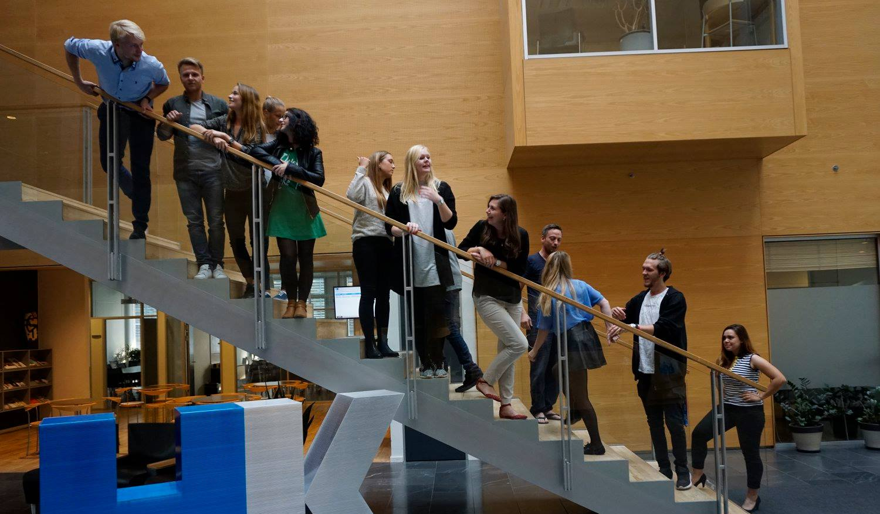
30th Board meeting
Cphbusiness Students
28.01.2019

Slide 2
Agenda
Approval of the agenda
Choice of minutes taker
Approval of the minutes (29th meeting)
Constitution of the board
Financial orientation
Status on planned activities Morning Welcome Event- Introbars – Fridaybars
Status on functions
Future activities
Next board meeting

Slide 3
1. Approval of the agenda

Slide 4
2. Choice of minutes taker

Slide 5
3. Approval of the minutes from the 29th board meeting

Slide 6
4. Constitution of the board
Cphbusiness Students Annual General Meeting was held November 15, 2018.
5 students were elected as ordinary board members 3 students were elected as alternates.
The election period is January 1th 2019 – December 31 2019

Slide 7
4. Constitution of the board
Ordinary members
Christoffer Lundberg
Emilie Holmbom Knudsen
Isabella Vesterskov Lehim
Malou-Cheanne Ananiassen
Daniel Mészáros
Alternates
1th alternate: Alexander Schibbye Vildenfeldt
2nd alternate: Bianca Polec
3nd alternate: Mie Louise Nielsen

Slide 8
4. Constitution of the board
According to Articles of Organization (statutes) §5 “The board must determine its own rules of procedure and constitutes itself with a chairman, a vice chairman, a treasurer and a secretary.”
Roles in the board: A: Candidates for chairman: Emilie and Daniel B: Candidate for vice chairman: Malou
Elected 15.01.19 as treasurer: Isabella Elected 15.01.19 as secretary: Anna

Slide 9
5. Financial orientation v/Isabella & Emilie

Slide 10
6. Status on activities
Introbar planned: City: 29 January 14 - 20 Søerne: 1 February 14 - 20 Lyngby: 1 February 14 - 20 Nørrebro: 8 February 14 - 18
Fridaybars planned for both Søerne and City Morning Welcome Event Lyngby: 28 January 08 – 09.30 Søerne: 31 January 10 – 11.30 Nørrebro: 4 February 08.30 – 09.30

Slide 11
7. Status on functions
HR:
Communication:
Bar:
Finans: Access to bank account has to be established (ADI responsibel). Due the articles of association, §7, chairman, vicechairman and tresasurer signs the organisation and can act individualley
Chairmanship; Consist of chairman and vicechairman

Slide 12
8. Future activities
Introduction meeting for students who want to be volunteers
Conference for all volunteers Date & Topic
Other suggestions?

Slide 13
9. Next Board meeting

