Slide 1
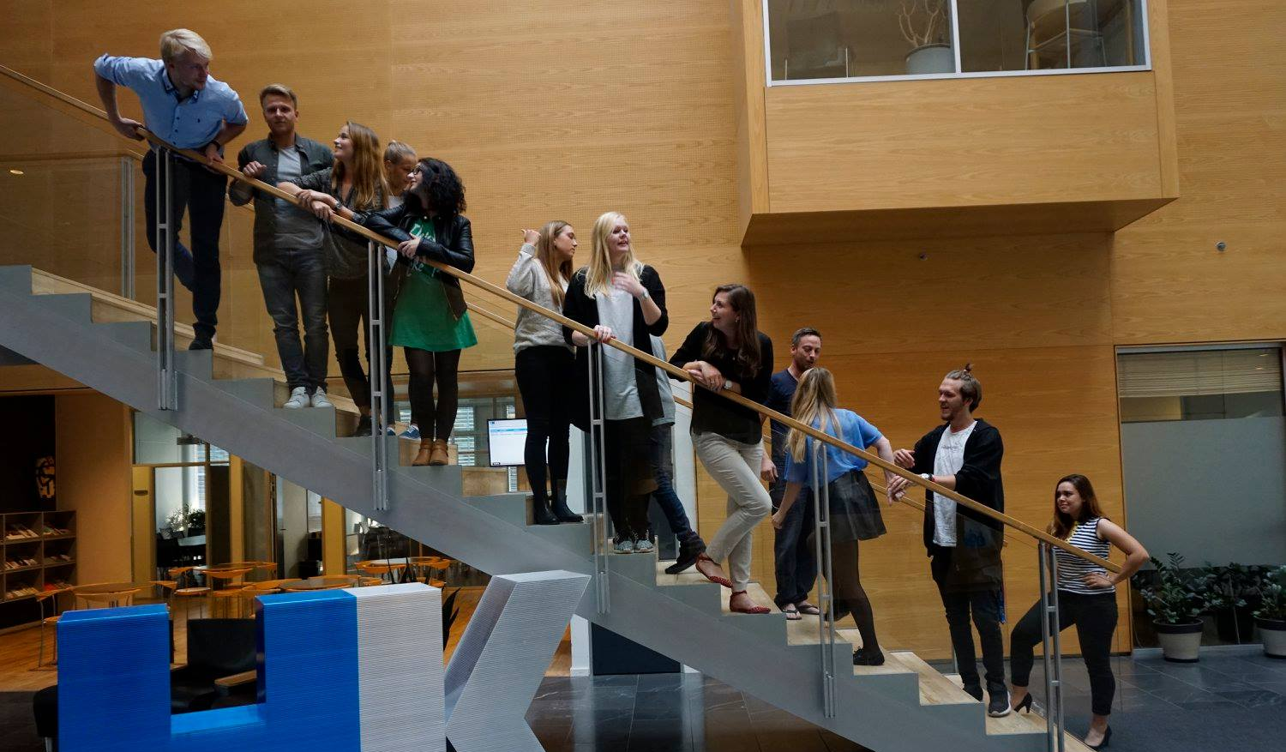
28th Board meeting
Cphbusiness Students
11.09.2018

Slide 2
Agenda
Approval of the agenda
Choice of minutes taker
Approval of the minutes (27th meeting)
Alternates – candidates
Orientation from the chairmanship
Financial orientation
Board members 2019
Other topics / Intro weeks
Evaluation of intro weeks by Søren Meyer
Next meeting

Slide 3
1. Approval of the agenda

Slide 4
2. Choice of minutes taker

Slide 5
3. Approval of the minutes from the 27th board meeting

Slide 6
4. Alternates – candidates
Nobody yet, we need to find some.

Slide 7
5. Orientation from the chairmanship
Intro weeks (will talk about that later)
Orientation about new contacts

Slide 8
6. Financial situation
Balance: 157.847,37
All known invoices and outlays has been paid.
Possibility to arrange extra activities and events for the students.
Eg. Booking a DJ to a fridaybar, bigger prices regarding tournaments or adjustments regarding the organisation – promotion, fridaybar etc.
Årsregnskab: https://docs.google.com/spreadsheets/d/1_Om332m0N9xzsLLOtn-RS4oZjrWdIN9Q-qAKZx1f18Q/edit#gid=399271589

Slide 9
7. Board members 2019
Leaving members
Anine
Kimie
Rikke
Louise
Samuel
Niclas?
New members?

Slide 10
8. Other topics?

Slide 11
8. Other topics
Intro weeks – how did it go?
Morning welcomes
Intro presentations
Intro bars
Upcoming intro events
Fælles I fælled
Intro to the student organisation
VEGA party?

Slide 12
9. Evaluation of intro weeks by Søren Meyer

Slide 13
8. Next Board meeting?

