Slide 1
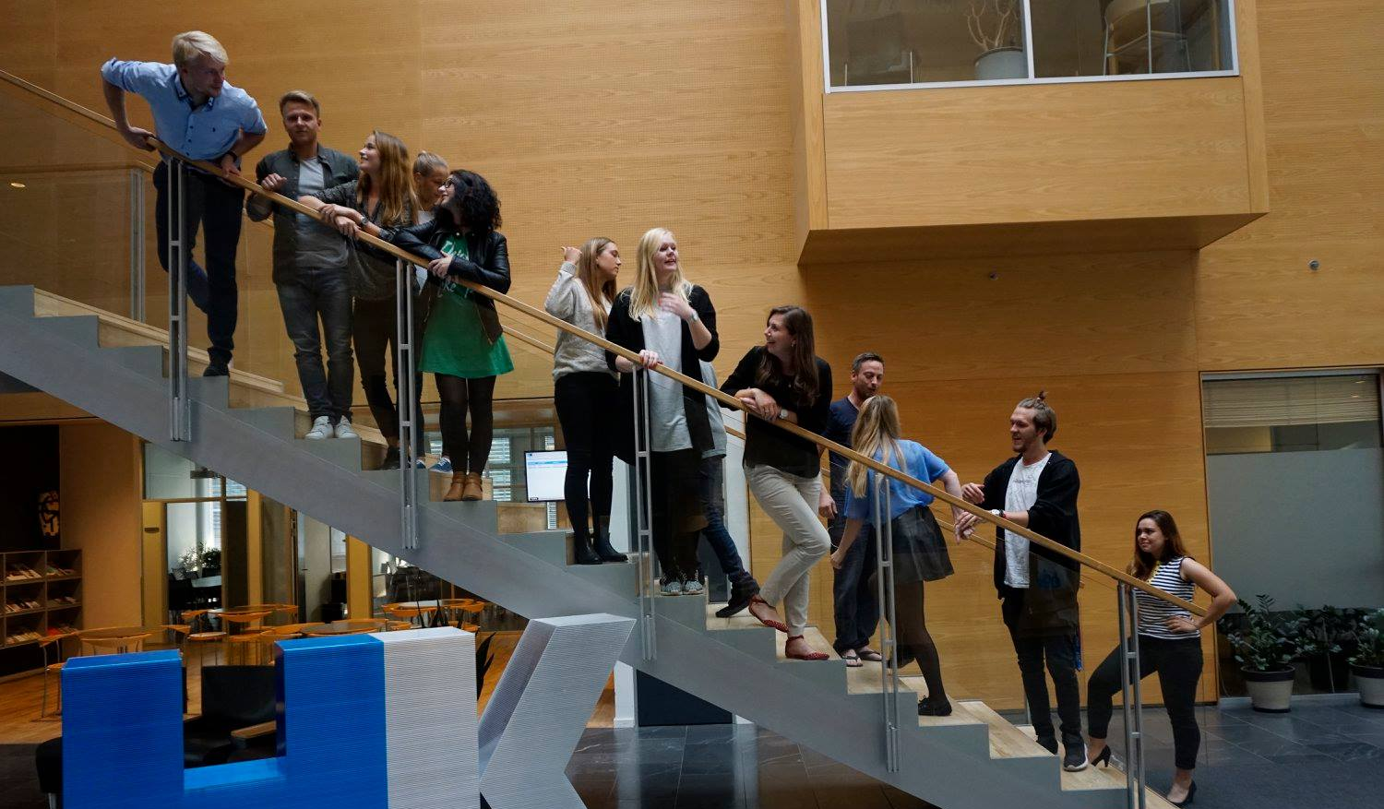
26th Board meeting
Cphbusiness Students
19.03.2018

Slide 2
Agenda
Approval of the agenda
Choice of minutes taker
Approval of the minutes (25th meeting)
Orientation from the chairmanship
Financial situation
Conference for volunteers
Collaboration with the Presidency of Cphbusiness
Other topics
Next meetings

Slide 3
1. Approval of the agenda

Slide 4
2. Choice of minutes taker

Slide 5
3. Approval of the minutes from the 25th board meeting

Slide 6
4. Orientation
Kevin is new alternate in the board:
Board: 5 members + 3 alternates
Anine (Chairman)
Samuel (Vice Chairman)
Kimie (Treasurer)
Rikke Boye
Niclas Andersen
Alternates - candidates:
Louise
Kristian
Kevin
Søren Meyer, Cphbusiness
Charlotte Dalgaard, Cphbusiness (secretary)

Slide 7
4. Orientation
Status on functions
Presidency: Anine & Samuel
HR: Kristian (??)
Finance: Kimie
Communication: Rikke & Linda?
Student political: (??)
Bar Manager: Kevin, Kamilla and Mads

Slide 8
4. Orientation
Status on activities:
Advisory Board meeting
Professional event
- Time management
10/4-2018 – Location: Søerne
Social event (hyttetur)
Intro weeks (summer)
- Start planning already
- Video (Who is responsible?)
Semester party?
Volunteer party?

Slide 9
4. Orientation
Student worker
Study and career (Cphbusiness) has been granted a student worker to support the student organisation together with Charlotte Dalgaard
Status?

Slide 10
4. Orientation
Status on systems
Most members is introduced and added to Trello.
We still want a webpage
- Can Nicoline introduce us to the one she already made?
- Competition for students at Cphbusiness?
iZettle
Can we find a cheaper solution to iZettle?
- Samuel has a suggestion

Slide 11
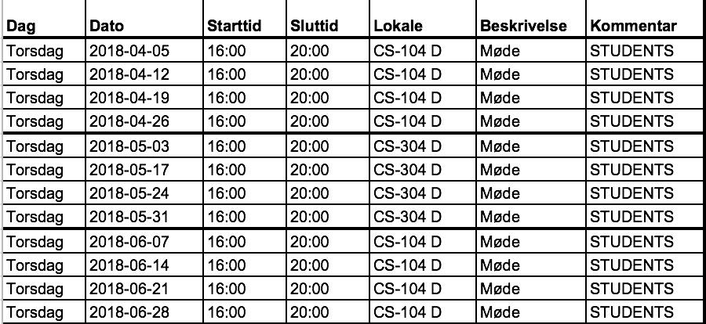
4. Orientation
Weekly workshop
Put on Facebook
Easier for volunteers to participate.
Easier for project managers to recruit.

Slide 12
Month | Volunteer activities | Social activities | Professional activities | Student political activities | Promotion activities
March | Conference for volunteers – ”volunteer management” (+social activity) | Friday bar (02/03) Friday bar (16/03) |  | Students’ board meeting
April | Status meeting (+social activity) | Friday bar (06/04) Friday bar (13/04) | Professional event – Time management | Advisory Board meeting Students’ board meeting
May | Status meeting (+social activity) | Friday bar (04/05) Friday Bar (11/05) Friday Bar (25.05) Semester party |  |  | Open House presentation
June | Celebration event for volunteers (in collaboration with HK) Status meeting | Friday bars (2) Event |  | Cphbusiness’ board meeting
August | Status meeting (+social activity) |  |  |  | New staff presentation
September |  | Intro event ”Together in Fælled” Intro-barer (x 4) Friday bars (x 1-2) |  | Advisory Board meeting Cphbusiness’ board meeting | Intro presentation

Slide 13
5. Financial situation
Current balance: + 78.029,84 DKK
Quarterly grant from Cphbusiness
- Every bill payed besides the DJ from last fridaybar (16/03) and the partybus.
- Requests:
Cable to the camera.
New phone for iZettle.
Cheaper iZettle solution.
NemID signatures for approving of minutes.
Studenterbolaget vs. new supplier?

Slide 14
5. Financial situation
Current status of Bank account access:
Kimie Patricia Trillingsgaard and Ida Sallerup Madsen.
Samuel and Anines almost have access, we only need one more signature from Kimie.
Presidency and Kimie are meeting in April to make the quarterly budget.
Notes:
bestyrelsesmøde.

Slide 15
6. Conference for volunteers
The conference was held 15 March
More than 20 participants
Successful workshop – what is the next step?

Slide 16
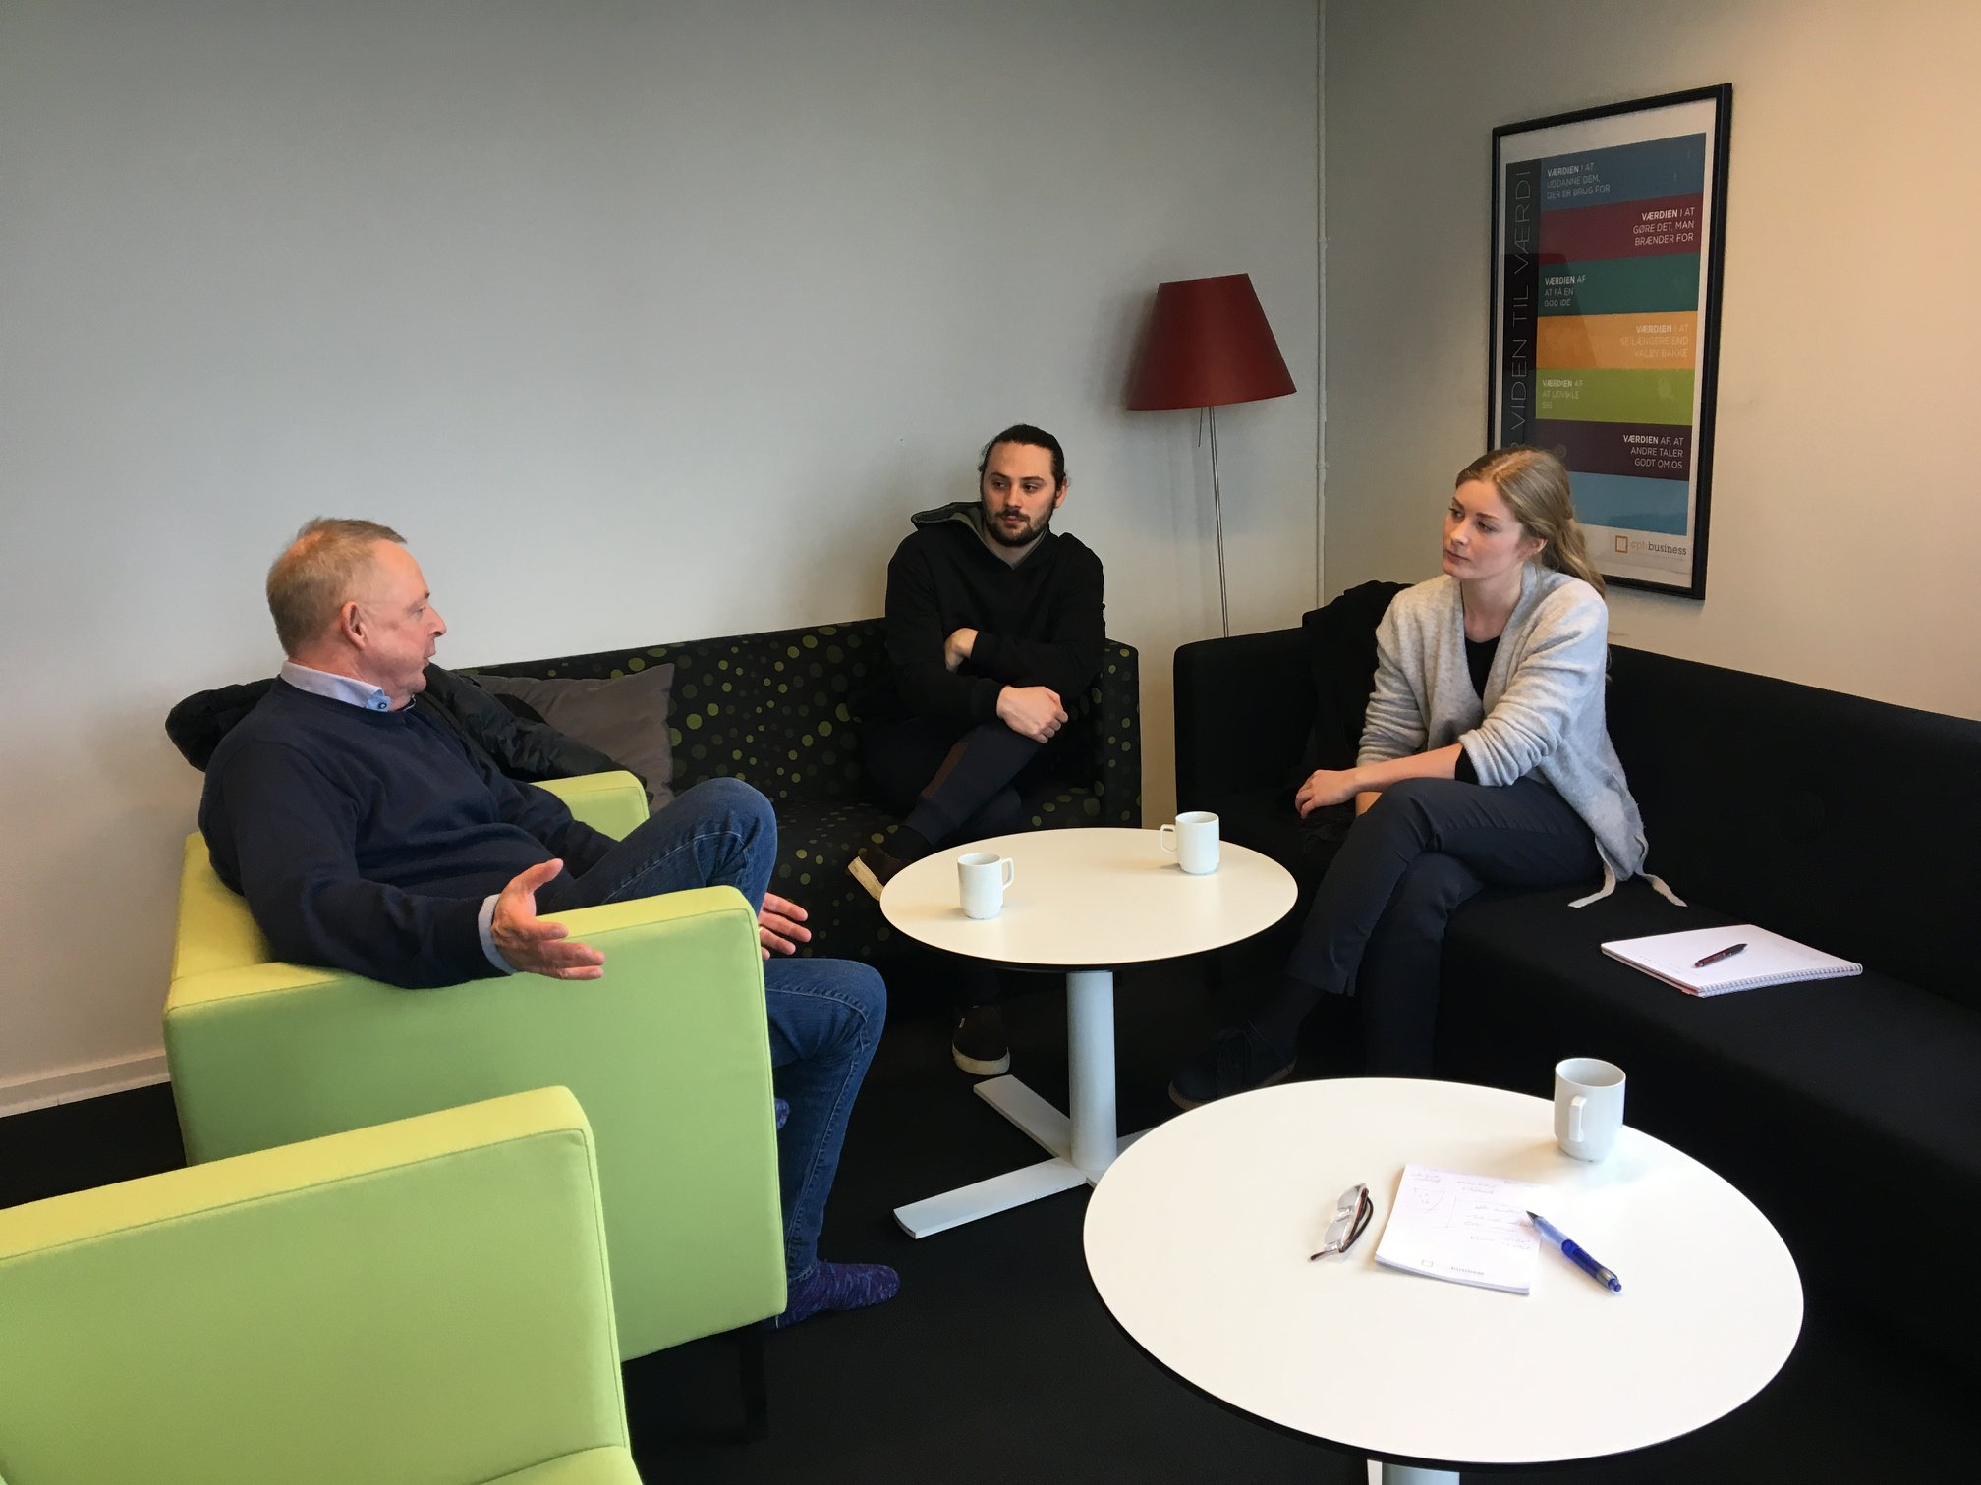
7. Collaboration with the Presidency of Cphbusiness
Meeting with Ole
The students representatives (chairmanship’s) responsibility
Tasks

Slide 17
8. Other topics?

Slide 18
9. Next Board meeting – date?

