Slide 1
Board of directors,
Cphbusiness Students
Meeting – 26.05.16

Slide 2
AGENDA
Approval of the agenda
Approval of the minutes from the last meeting
Orientation / Charlotte
Chairman candidate / Interview Panel
Guidelines for the Board of directors / Charlotte
Advisory Board / Charlotte
SWOT presentations / everyone
Financial situation / Finance
Status from HR / HR
Status from Business / Business
Visit from Campus Student Council
Other topics
Next meeting

Slide 3
1. Approval of agenda?

Slide 4
2. Approval of minutes
from the last meeting?

Slide 5
3. Orientation
/ Charlotte
Consequences of deleting §6 in the formalities:
Waiting for response from lawyer
Financial situation 2015
Tuesday workshops - Status?
Fælles i Fælled/Study Start Day
Meeting Tuesday 31/5 16:00-17:30
Cphbusiness Søerne, meeting room 0.03
Join us!

Slide 6
3. Orientation
/ Charlotte
4.01: Booking system ready tomorrow!
Future room:
1 x meeting table + 2 x desks = OK?
Opportunity: business idea
Idea from a teacher – Cphbusiness suggested it should be placed in the student organisation
Sell focus groups to companies!
Project for Business department:
Let’s meet up with the teacher

Slide 7
4. Chairman candidate
Sebastian Pilgaard Laursen
Current situation:
1st semester in Service, Tourism and Hospitality Management at Cphbusiness Lyngby
Alternate in the board of directors since April 2016
2nd hand in the Finance department
Experience:
Coach and Sports Manager of Handball teams
Treasurer in board of directors
Motivations:
Improving the student organisation internally and strategically.
The student political aspect.

Slide 8
4. Chairman candidate
The interview panel’s recommendation
Sebastian
Frederik
Charlotte
Vote:
Should Sebastian be offered the job as the new chairman of the student organisation?

Slide 9
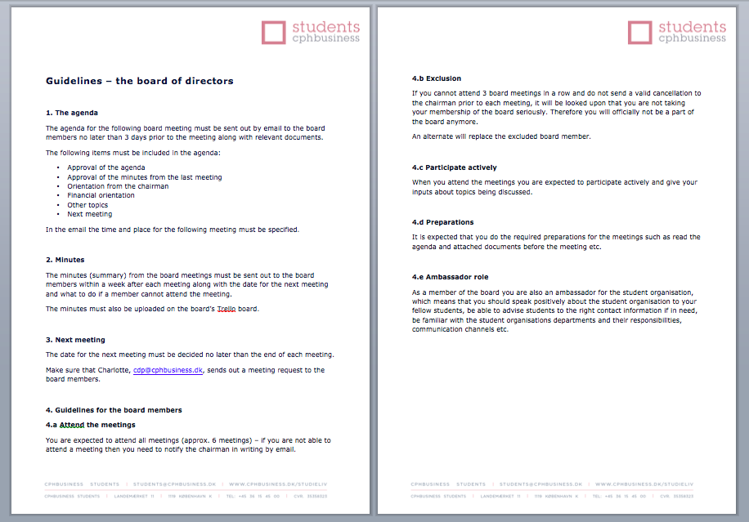
5. Guidelines for the Board
/ Charlotte
Approval?

Slide 10
6. Advisory Board
/ Charlotte
Structure suggestion:
3 x Board members: chairman, vice chairman and Cphbusiness employee representative
4 x External members – suggestion:
Anders Lauritsen from Studenterbolaget/Monso
Ulla Trolle from Trolle Marketing
Merete Brunander from Brunander Consulting
Maria Fauerby from HK
1 x Cphbusiness staff members - suggestion:
Henriette Volmers from Cphbusiness Partner
Formulate vision, purpose and tasks
Formulate rules for the advisory board
Let’s from a work group!

Slide 11
7. SWOT PRESENTATIONS
– task for today
Task for each department:
Analyze the SWOT – what can your department do
To turn weaknesses into strenghts?
To exploit the opportunities?
To avoid threats?
Let’s see the action plans!

Slide 12
SWOT – ACTION PLAN
COMMUNICATION DEPARTMENT
To avoid threats?
Knowledge and knowhow is leaving when the students are leaving
Guidelines, summaries, Dropbox, the new mail “system”
To exploit the opportunities?
Many companies want us as partner
Have a good visual presentation
New members = new ideas+potential
Have meetings, and delegate,
managers forward ideas at management meetings
Staff
The newsletter for teachers and students
Students, Students are online, Access to the students – real life
More content of what we do (Newsletter, “behind the scenes” etc)
Continue collaboration with Microsoft and HK, Sponsors
Make sure to post HK visits at campus, make sure to produce quality products, which present partners good

Slide 13
SWOT – ACTION PLAN
COMMUNICATION DEPARTMENT
To turn weaknesses into strengths?
Better marketing, more members, Active members should be active, get a camera, update guidelines and publish, members ideas should be taken up at management meeting, train own members regard the
other departments.

Slide 14
SWOT – ACTION PLAN
HR DEPARTMENT
WEAKNESSES
Lack of communication internal and external
OrangeHRM gives you an easy access to all the active members contact details. You can easily find them sorted by department, campus, job title, etc.
Weak marketing + FB marketing
We will help sharing the material throughout the social media.
Active members need to help with the communication
Actives lack understanding of how social media works - how there needs to be activity. We can explain the importance of that during the first interview.

Slide 15
SWOT – ACTION PLAN
HR DEPARTMENT
WEAKNESSES
Lack of knowledge of the student organisation
Post the job postings to the FB groups, like and share it!
Create posters with “How to apply” with QR code
Use a link with vacancies in the Newsletter
Lack of structure
Introduce Trello to the new members during the first interview. Trello is a good way to structure our daily work throughout the organisation and once introduced to it from the beginning it should help to keep it structured.

Slide 16
SWOT – ACTION PLAN
FINANCE DEPARTMENT

Slide 19
SWOT – ACTION PLAN
BAR DEPARTMENT
STRENGHTS
Friday bar makes profit
Motivated bartenders
Access to students every week
WEAKNESSES
Lack of communication:
We can plan ahead, so the Communication department has time to prepare the promotion of the Friday Bars
Weak marketing:
We can use bartenders for sharing and posting pictures, as well as working closely with the Communication department to promote Friday Bars.
We can create short, entertaining and catchy event descriptions.

Slide 20
SWOT – ACTION PLAN
BAR DEPARTMENT
WEAKNESSES
Students lack knowledge of the student organisation:
We can give a proper introduction of the Bar department during the intro days
Active members not participating in marketing:
We can actively encourage bartenders to post photos from the Friday Bars on social media using hashtags; sharing, liking and inviting.
Putting out fires instead of planning:
Planning Friday Bars ahead, not only the closest one.
Evaluating after each one to see what works and what doesn’t.
Not aware of the right contact people:
Have created list of contact people

Slide 21
SWOT – ACTION PLAN
BAR DEPARTMENT
OPPPORTUNITIES
New members bring new ideas
Students are online
Access to the students in real life
Many companies wants us as partner / sponsor us
THREATS
Knowledge and knowhow are leaving
Every procedure, contact people etc. is documented and left for newcomers.
New people are trained to take over.

Slide 22
SWOT – ACTION PLAN
EVENT DEPARTMENT
Lack of communication internal and external
Focus on own department internal communication and effectively communicate to other departments through meetings/ reports
Weak Marketing
Event department can contribute through online and offline promotion
Lack of knowledge of the student organisation
Every time there is an event post a link to the student organisation website as well the members of the department may be ambassadors
Organise more smaller/social events, to get more involved in the daily student life (Like tours around the city for the new comers, as we introduce them to their new home: tips on best student places etc. In this way the student organisation will get closer to the new students)

Slide 23
SWOT – ACTION PLAN
EVENT DEPARTMENT
Lack of structure
Organise the work in the Event Department. Try different ways and find out the one that works
Communicate more efficiently through school email, using project management tools
No financial Control
In the event department there could be a secretary that will track all finance and documentation from department and then to report to the finance department

Slide 24
SWOT – ACTION PLAN
EVENT DEPARTMENT
Lack of seriousness
Motivate the members of the department to work serious and with passion/ introducing “Volunteer of the semester” with a small reward
To document all the work we do (Guidelines, Excel Sheet etc) that will serve as material for the annual/semester report of the department, where the progress can be tracked
Not aware of the right contact persons at the Cphbusiness
The Event Department will start a sort of Data Base where all the contacts, positions etc. can be written while working with them and then share it with other departments and to further build it for everyone's accesses.

Slide 25
SWOT – ACTION PLAN
EVENT DEPARTMENT
Lack of understanding of own and others tasks
Write the guidelines for the department and make sure it is respected during the work. Make a volunteer contract for the new members, so they understand the seriousness of being part of organisation
Held department meetings on the regular basis ex: once a month and get update on what the progress of the work is

Slide 26
SWOT – ACTION PLAN
BUSINESS DEPARTMENT
- Lack of knowlegde of the Student Organisation→Roskilde festival
Lack of Structure → Head to expand the department rules. While the famous guidelines will be conducted in unity.
Lack of collaboration → Expand the BD workshops to the entire organization, create culture with new volunteers towards collaboration( together with HR)
Seriousness→ better to identify unserious members and assign them to better suited roles.
Planning ahead→ Pre semester start, having the semester sketched out with the events relevant etc.

Slide 27
8. The financial situation
/ Head of Finance
Balance: + 44,144.90 DKK
Grant from Cphbusiness: on its way
Meeting at the bank Monday
E-conomics will be replaced this week
Workshops – find templates on Trello
Longer credit at Studenterbolaget
Now 3-5 days, manually payment
Offer: 10-11 days, automatically payment
Amount limit for a single purchase: DKK 30,000 - Let’s vote
Notes:
Please add current account balance
Then I wanted to quickly inform others about e-conomics being replaced within next few day/week, but since we have already talked about it I’m not sure if it’s relevant this time
and also inform them that the account will be online accesible next week as we already have all the signatures and you and I are going to the bank ☺
Regarding workshops- I think they went really well and were very helpful for us especially for setting rules and creating proper templates. The only thing is the attendance, but you’have already talked about it on FB Managment Group. And please,I wanted to remind them they can find the templates on trello and from now on they can only send them to finance@cphbusiness.dk
I have searched between previous budget I have and the amout limit is quite difficult to set, because the amounts for events are very different. What I suggest is: as we have already agreed, all budgets needs to be approved by Finance Department. The most often used amount is 30 000 DKK for Friday Bars. So I sugest either every amout over 30 000 DKK being approved by board, or every amount over 70 000 DKK (which won’t include smaller parties, but for example Semester Parties will be included).

Slide 28
Bank account for Friday Bars
17/6: Meeting with Bar Department and Filip Lange
Topic: 1 x account or 2 x accounts (normal account and a Friday bar account).
Pros according to Filip:
You have to make sure that Friday bars only use this account and always use it! It’s the biggest issue in regards to profit and loss in the daily operation.
If you have a separate account for the Friday bars it is easy to see if you have problems with the finances - but you will also be able to do that in the profit/loss accounts.
Notes:
We have agreed with Bar Department on meeting regarding this task, where we are planning to go through all the pros and cons of this idea. Hopefully Filip will also attend and guide us through the process, but if not, I have already talked about it little bit more with him and this is his answer summing up the pros and conditions for having the separate account for Friday Bars. There is no big discussion needed at the moment since we are not planning to create separate account until summer vacation (we have to consider everything relevant and it will take more time).

Slide 29
9. Status from HR
/ Head of HR
COURSES AND EVENTS
Active Members Party
Remember to sign up! Deadline: 1 June
Nominate the Best Active Member
Afterparty: Kant Bar & Cocktails
Course in How to lead volunteers by HK
Final date: Tuesday 21/6 from 16:00-18:00
Where: Cphbusiness Søerne
Trello workshop: Who is coming?
8/6 from 18:00 - 19:00 (after the board meeting)
Active Members Day
Poll result: Thursday 29/9 from 16:00-21:30
Waiting for HK to confirm

Slide 30
9. Status from HR
/ Head of HR
Positions - bartender applicant
Upcoming open positions:
Finance department
Others?
Update the database
Mail signature

Slide 31
10. Status from Business
/ Head of Business
Full focus on Roskilde Festival and the Study Start Day.
Study Start Day:
Catalina and Edvinas is part of the Study Start project group (rest of BD joins after Roskilde)
Roskilde festival:
Last formalia to be done
5 People M, 9 deposit and 20 interested + 2 non-students
Next steps:
Hosting the Camp Day meeting
Getting more volunteers
Promoting the Roskilde event

Slide 32
11. Visit from CSC in Lyngby
Welcome to Martin, Marta and Hakim
The tasks and purpose of the Campus Student Council?
Current projects?
Next step: How to secure a good collaboration between the student organisation and CSC

Slide 33
12. Other topics

Slide 34
Next meetings
Wednesday 8/6 16:00-18:00
Tuesday 21/6 13:00-15:00 Wednesday 22/6 10:00-12:00 or 12:00-14:00?

