Slide 1
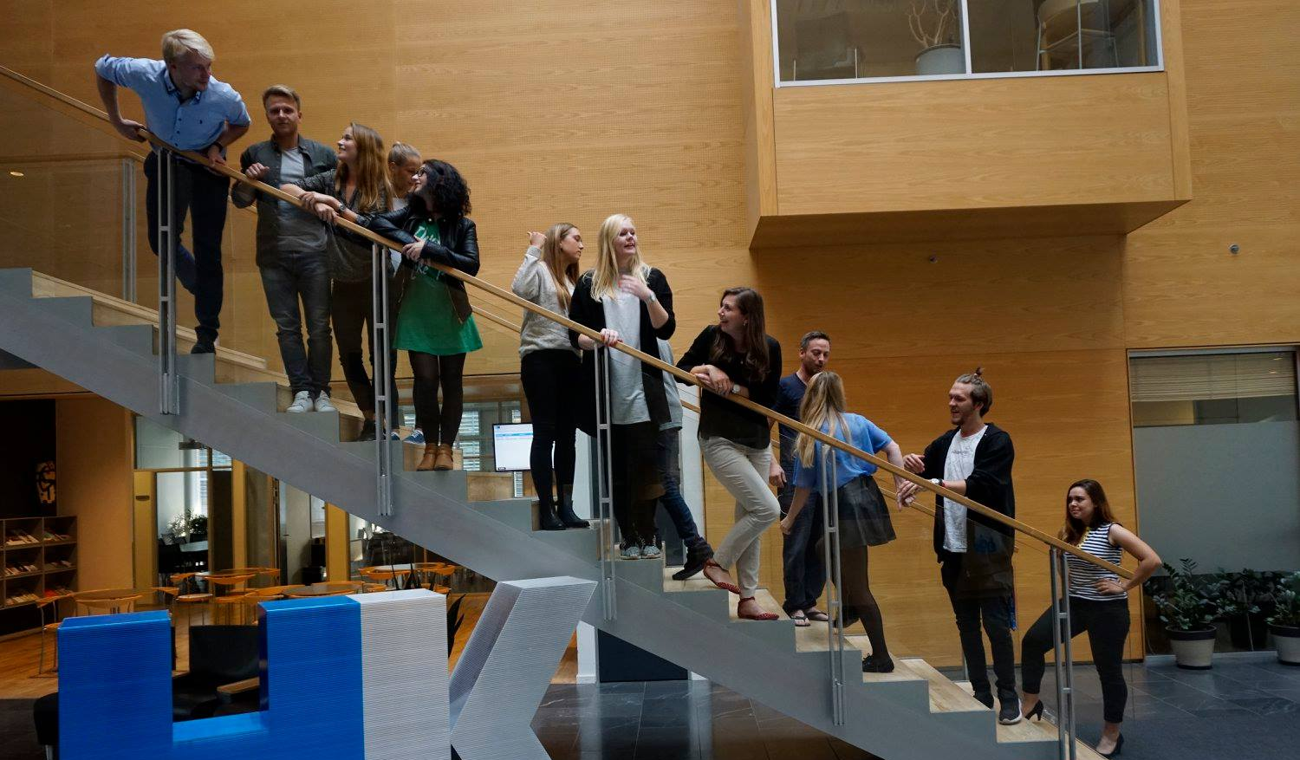
48th Board meeting
Cphbusiness Students
25.01.2022

Slide 2
AGENDA
Approval of the agenda
Choice of minutes taker
Approval of the minutes
Constitution of the board
Board meetings for the whole year
Financial situation / Treasurer
Activities – spring 2022
Other topics
Next meeting

Slide 3
1. Approval of the agenda

Slide 4
2. Choice of minutes taker

Slide 5
3. Approval of the minutes from the 47th board meeting

Slide 6
4. Constitution of the board
Board roles: chairman, vice chairman, secretary, treasurer
Ordinary members and alternates
Student representatives in the academy’s board of directors
Student representatives in DESO

Slide 7
5. Board meetings 2022
49th board meeting – 5 April 2022
50th board meeting – 16 August 2022
51st board meeting – 16 November 2022
It is volunteer how often the
management have meetings.

Slide 8
6. Financial situation
Balance on the bank account:
+197.774,75 DKK
Current bank account access: Nicoline
Two more access: who?
Expenses for:
Activities to enhance the student environment for all students at Cphbusiness
Operating the student organization
Motivation of the volunteers

Slide 9
7. Activity wheel – Spring 2022

Slide 10
7. Activity wheel – Spring 2022
Recruitment activities:
Video on Hello Flow (new students)
Introduction meeting (date, time, responsible)
Volunteer activities:
Conference for volunteers in February/March (HK?)
Status meetings for all volunteers – dates and time

Slide 11
8. Other topics
Internal communication guidelines
NEW PROJECT: Restart of the study environments. Collaboration between Cphbusiness and the student organisation
Status on the project: Empowerment of the student involvement at Cphbusiness
Volunteer management

Slide 12
9. Next board meeting
49th Board Meeting
5 April 2022

