Slide 1
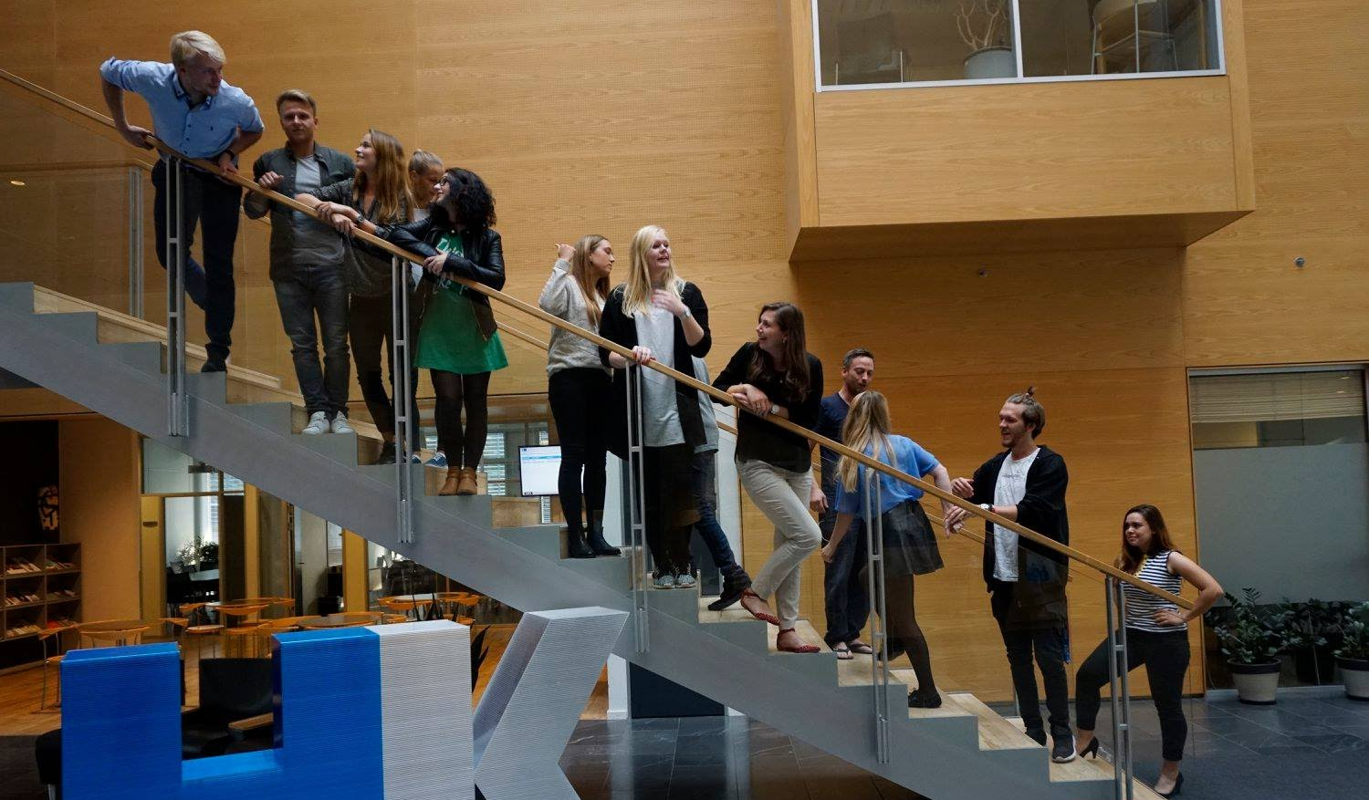
44th Board meeting
Cphbusiness Students
18.01.2021

Slide 2
Agenda
Approval of the agenda
Choice of minutes taker
Approval of the minutes (43rd meeting)
Collaboration with HK (guests from HK - Dorte and Augusta)
Constitution of the board
Board meetings for the whole year
Annual general meeting
Orientation from chairmanship
Financial situation / Treasurer
Orientation from the student representatives in the Cphbusiness’ board of directors
Collaboration with business partners
Activities - spring 2021
Other topics
Next meetings

Slide 3
1. Approval of the agenda

Slide 4
2. Choice of minutes taker

Slide 5
3. Approval of the minutes from the 43th board meeting

Slide 6
4. Collaboration with HK
Guests from HK:
Dorte Omdal
Augusta Palm Ehrenreich

Slide 7
5. Constitution of the board
Board members:
Nicoline Ravn Grønbech
Jamie Marie Schmidt
Monika Gailiute
Angel Manuel Fernandez Alcantara
Jana Bubáková
Charlotte Dalgaard, Cphbusiness
Board: 5 members + 3 alternates
Chairman: Angel Manuel Fernandez Alcantara
Vice Chairman: Jana Bubáková
Treasurer: Nicoline Ravn Grønbech (representative in board of directors)
Monika Gailiute
Jamie Marie Schmidt (representative in board of directors)
Secretary: Charlotte Dalgaard
3 Alternates – no candidates

Slide 8
6. Board meeting 2021
44th meeting: 18 January 2021 (16:30)
45th meeting: 8 April 2021 (16:30)
46th meeting: 6 September 2021 (16:30)
47th meeting: 11 November 2021 (16:30)

Slide 9
7. Annual General Meeting 2021
Date suggestion:
November 3rd 16:30 – 17:30

Slide 10
8. Orientation from the chairmanship
Status on volunteers (48, 10 graduating):
Teams:
Communication + Events: 27
HR: 9
Finance: 8
Status on managers of functions:
HR: Jamie (Jana)
Communication + Events: Monika (Angel)
Finance: Nicoline (Jamie)
Student politics: Angel (Jana)

Slide 11
9. Financial situation
Nicoline - treasurer
Balance
Bank access
Status on the auditor’s observations of accounts

Slide 12
10. Orientation, student representatives
Introduction meeting: 11.03.2021 14:00
Board meetings in the Cphbusiness board:
First board meeting: 12.04.2021 15:00
Summer meeting: 23.06.2021 15:00
Strategy seminar: 23. - 24.09.2021 12:00
Budget meeting: 25.11.2021 15:00

Slide 13
11. Collaboration with BPs
HK
Cphbusiness Alumni
Sportyfied (webshop: https://cphstudents.sportyfied.com/da)
Student discount (Moodle: https://cphbusiness.mrooms.net/course/view.php?id=203#section-7)
ESN Erasmus Student Network:https://esn.org/

Slide 14
12. Activities - spring 2021
Events:
Introduction meeting with new volunteers
Other ideas:
World Day of Cultural Diversity for Dialog and Development (May 21)
Escape rooms
Psychological help for students
Students’ small ‘societies’ (groups/clubs)
Investments (Female Invest? Danish)
Lean In
Guidelines for students (collab with ESN)
Zoom Open Mice, Quiz,
Meet other culture on zoom

Slide 15
13.Other topics?

Slide 16
14.Next Board meeting 45th
– 8 April 2021 at 16:30

