Slide 1
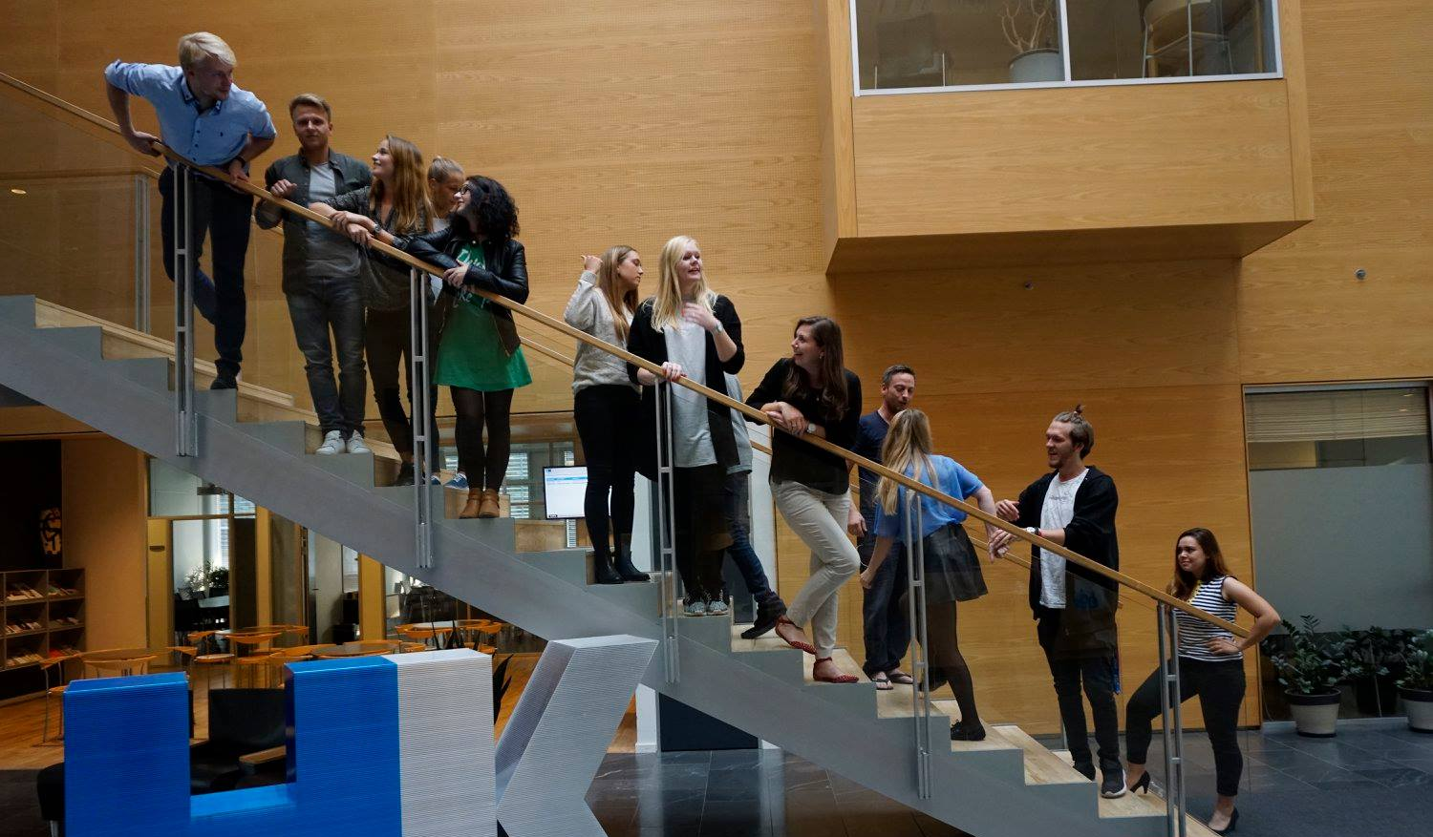
43rd
Constituent Board meeting
Cphbusiness Students
19.11.2020

Slide 2
Agenda
Approval of the agenda
Choice of minutes taker
The board’s responsibility and tasks
Roles in the board
The guidelines for the board
The formalities of the student organisation
Board meetings 2021
Other topics
Next board meeting

Slide 3
1. Approval of the agenda

Slide 4
2. Choice of minutes taker

Slide 5
3. The board’s responsibiity and tasks
The board works with the strategy and the daily tasks e.g. ensure that the strategy is executed, follows the budget and reaches the goals accordingly to the purpose and objectives of the organisation.
The board is responsible for:
developing the strategy of the student organisation
setting the goals for the student organisation (Activity plan)
allocating the overall budget for the student organisation
developing strategic partnerships and collaborations
keeping the student organisation updated about the development of Cphbusiness
handling student political issues

Slide 6
4. Roles in the board
Roles:
Chairman
Vice chairman
Treasurer
Secretary

Slide 7
4. Roles in the board
Chairmanship (Chairman, Vice Chairman, Secretary)
Responsible for:
Finance: overview of finances and approval of minor budget changes (with treasurer)
Projects: follow-up on projects and the project goals
Volunteer welfare, motivation and well-being
Representing the students of Cphbusiness and the student organisation (preferred student representative(s) in Cphbusiness’ board of directors)
Planning and executing the board meetings, the annual general meetings, information meetings, the volunteer conferences and status meetings for volunteers.
Database of sponsors and business partners
Executing the rules of procedures
Managing the systems (email accounts, Sharepoint etc.)

Slide 8
4. Roles in the board
Treasurer
Responsible for:
Managing invoices and outlays
Managing the accounts and budgets
Approval of minor budget changes.

Slide 9
4.Roles in the board
Constitution of roles:
Chairman – who?
Vice chairman – who?
Treasurer – who?
Secretary – who?

Slide 10
4. Roles in the board
”The ordinary members and the alternates must be students at Cphbusiness, and should be elected among the volunteers in the student organisation. The election should be based on experience within the student organisation and relevant skills. If possible, the alternates should be 1st or 2nd semester.”
Type of board members:
5 ordinary members
Who?
3 alternates
Who?
Other tasks:
Two student representatives in the academy’s board of directors
Who?

Slide 11
5. Guidelines for
the board
Any questions?

Slide 12
6. Formalities of
the student organisation
Any questions?

Slide 13
7. Board meetings in 2021
44th meeting: January 11/1 or 14/1
45th meeting: April 8/4 or 15/4
46th meeting: September 6/9 or 9/9
47th meeting: November 1/11 or 11/11

Slide 14
8. Other topics
Meeting with HK
Status on the collaboration with HK
Find a date
Development of the student involvement at Cphbusiness:
Survey on its way
Involvement of students through the student organisation’s SoMe platforms
Focus group with the volunteers in the student organisation
Invitation for webinar 3/12 from 14-17.
Would any of you like to participate?

Slide 15
9. Next Board meeting
18. January 2021

