Slide 1
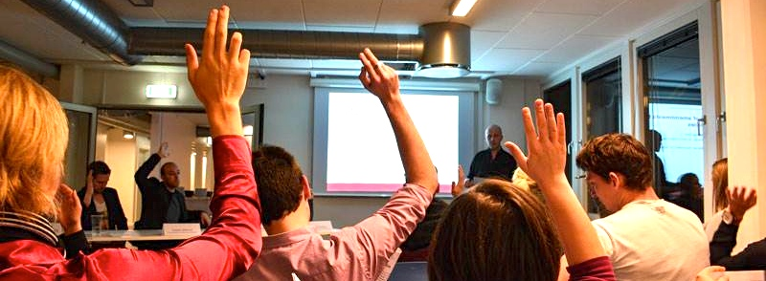
21.11.2019
Annual General Meeting

Slide 2
Agenda
Election of moderator
Election of referent
The boards’ report
Budget and financial report
Auditors’ observations of the accounts
Approval of financial statements
Member topics
Election of board members and alternates
Election of auditor(s)
Optional

Slide 3
1. Election of Moderator

Slide 4
2. Election of Referent

Slide 5
3. The boards report
Visit from Tommy Ahlers
Tomme Ahlers visited us at Søerne, where we had a debate regarding his mission to fight against “the perfect I”
HK Workshops for Volunteers
Spring workshop – communication, cooperation & values.
Fall workshop – Human values, strategic management & recruitment.

Slide 6
3. The boards report
Speaking at the teachers annual conference
Every year the teachers has a conference, this year the Student Organisation was invited to speak a little about what we think is important for the students at Cphbusiness. Here I talked about the social environment and our dreams of where it should be.
Summer Party
A cosy get together for the volunteers to finish of the semester

Slide 7
3. The boards report
Study start
Both last semester and especially this semester, we have made a lot of visits in the new classes around campus’, to greet the new students and inform about the Student Organisation.
Friday bars
Last semester we had a great amount of Friday bars. Do to various reasons in this semester, manly volunteers in their internship, we haven’t had that many Friday bars.
Should we consider an other solution structure wise regarding Friday bars? Having professionals arranging the bars, so that there will be a more consistency

Slide 8
3. The boards report
Intro bars
In six days we had 7 intro bars for all the new students to make their start more festive, fun and social.
Fælles i Fælled
As the traditions sates, we had Fælles i Fælled 14th of September. A day where we had a great party in cooperation with HK.
Intro meetings
This semester and last semester, we had an intro meeting for all the students, who would like to become a member of the Student Organisation.

Slide 9
3. The boards report
Winter Party
We are planning on having a winter party this semester, to finish in style

Slide 10
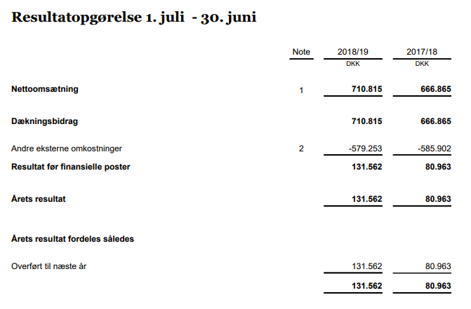
4. Budget and Financial Report

Slide 11
4. Budget and Financial Report

Slide 12
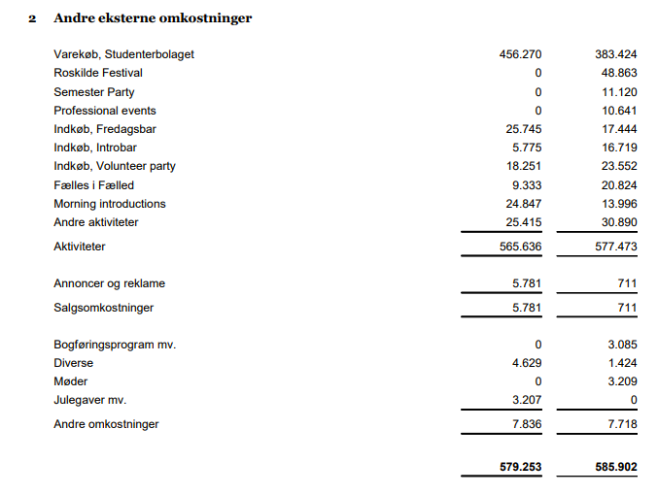
4. Budget and Financial Report

Slide 13
5. Auditor’s observations of the accounts
”The annual accounts gives an accurate image of organisations assets, debt and financial position as of 30. june 2019” (translated)

Slide 14
6. Approval of financial statements
Do you approve?

Slide 15
7. Members topics
No topics received

Slide 16
8. Election of board members and alternates
Ieva Gezeviciute
Oliver Daniel Koch
Isabella Lehim
Arturas Mickevicius
Mille Koch Rømer

Slide 17
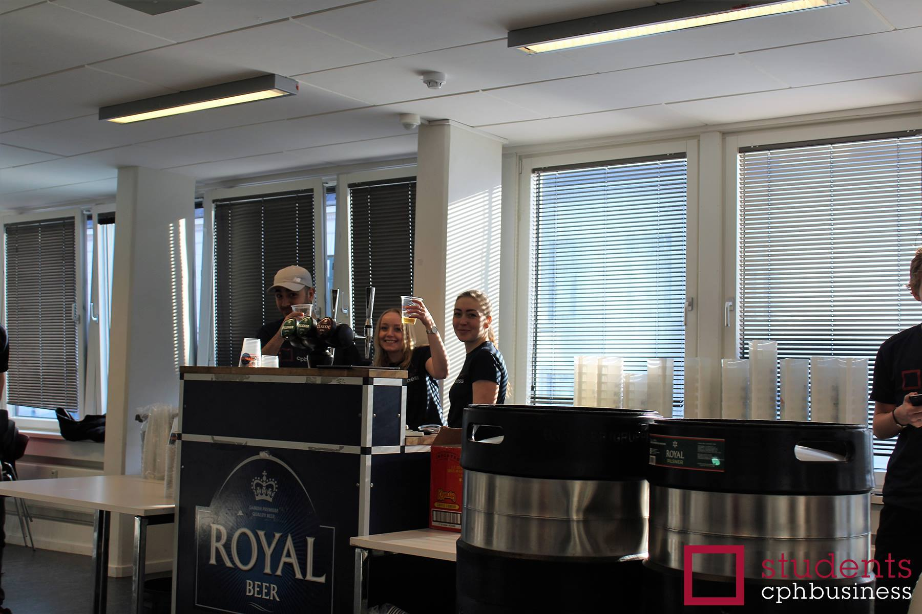
Mille Koch Rømer
Background
Students member
Service, Hospitality and Tourism Management AP
Innovation and Enterpreneurship Top-Up
Internship
Voluntary work

Slide 18
9. Election of auditor(s)
We suggest that we choose the school’s auditor Carsten Blicher from PriceWaterHouseCoopers (pwc)
He has been the auditor for the organisation for many years.
Approved?

Slide 19
10. Optional

