Slide 1
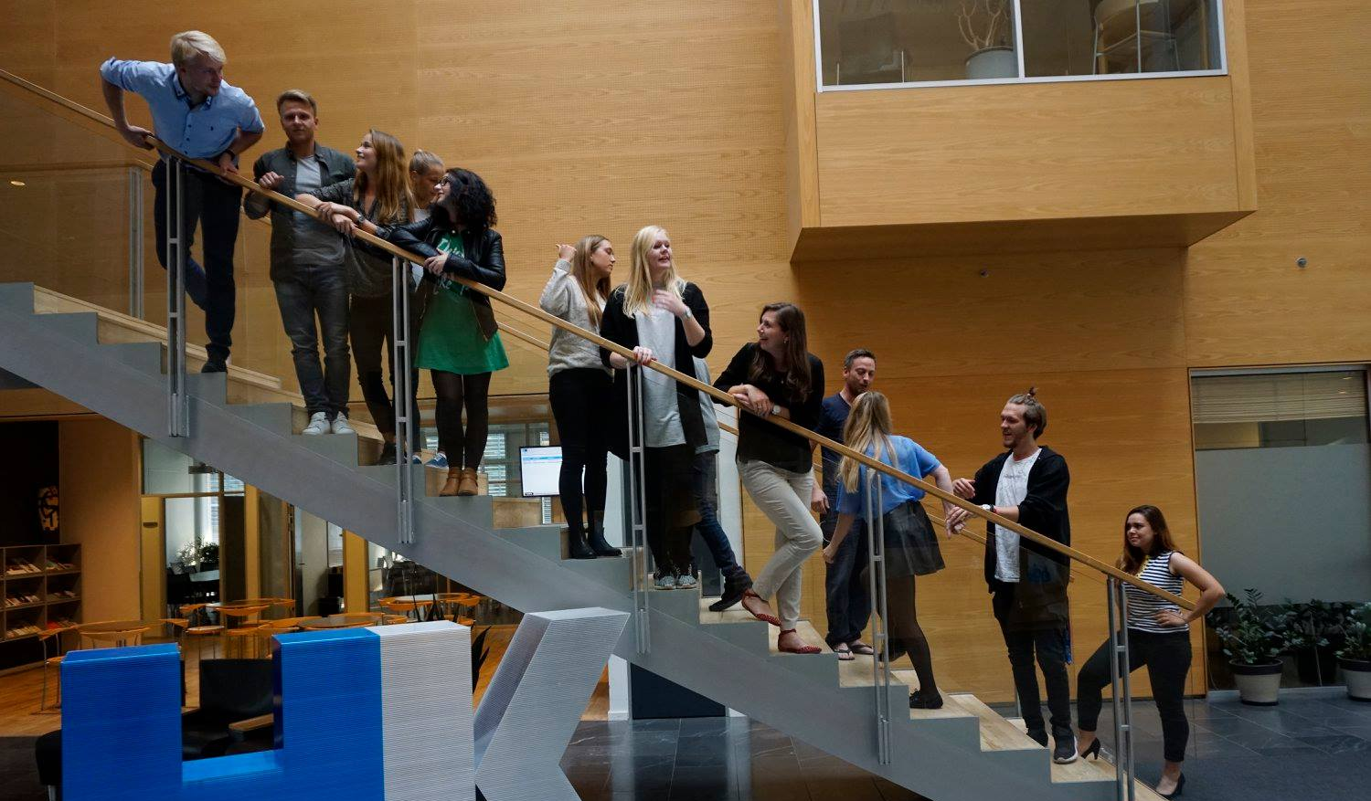
35th Board meeting
Cphbusiness Students
09.10.2019

Slide 2
Agenda
Approval of the agenda
Choice of minutes taker
Approval of the minutes (34th meeting)
Choose content for HK workshop
Friday bar orientation
AGM
Next board meeting

Slide 3
1. Approval of the agenda

Slide 4
2. Choice of minutes taker

Slide 5
3. Approval of the minutes from the 34th board meeting

Slide 6
4. Choose content for HK Workshop
Current suggestions: - Strategic management - Time management - Debate
Other suggestions?

Slide 7
5. Friday bar orientation
What is the current situation?
What are the final agreed dates?
Afterparties
What needs to be done?

Slide 8
6. AGM
Date needs to be agreed on - Suggestion: 21st of November
Agenda for the AGM ← Last years agenda

Slide 9
7. Next Board meeting

