Slide 1
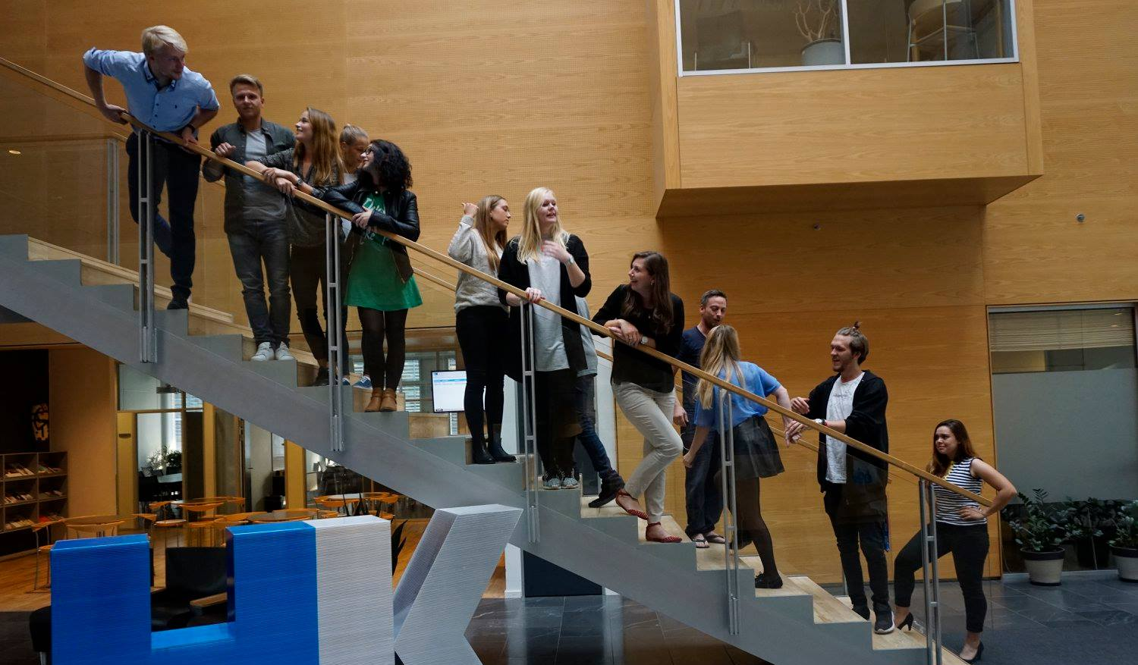
31th Board meeting
Cphbusiness Students
05.03.2019

Slide 2
Agenda
Approval of the agenda
Choice of minutes taker
Approval of the minutes (30th meeting)
Welcome to Michelle from HK
Financial orientation
Status after intro meeting – on boarding
School board members
Future activities – summer party, social & political
Status meeting
Next board meeting

Slide 3
1. Approval of the agenda

Slide 4
2. Choice of minutes taker

Slide 5
3. Approval of the minutes from the 30th board meeting

Slide 6
4. Welcome to Michelle from HK
Michelle will introduce herself and her function in HK and our future cooperation

Slide 7
5. Financial orientation w. Isabella
How are we doing
What is status on bank account acces

Slide 8
6. Status after intro meeting
How did it go?
Where do we need to focus on implementing new members?
What can we do better next time?

Slide 9
7. School board members
Candidates: Emilie & Malou-Cheanne
Current members: Anine & Samuel

Slide 10
8. Future activities
Fridaybars planned for both Søerne and City
Social event in April
Summer volunteer party
Student politics

Slide 11
9. Status meeting
What is this?
Would we like to start it up?

Slide 12
10. Next Board meeting

