Slide 1
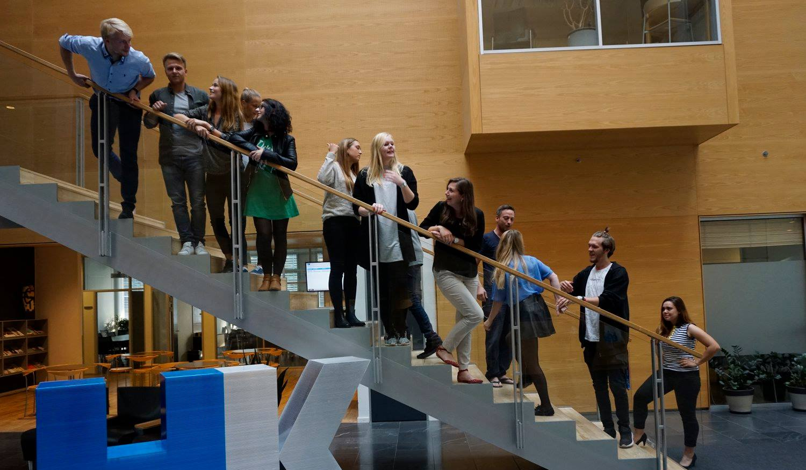
27th Board meeting
Cphbusiness Students
09.05.2018

Slide 2
Agenda
Approval of the agenda
Choice of minutes taker
Approval of the minutes (26th meeting)
Orientation from the chairmanship
Financial situation
Strategy
Other topics
Next meetings

Slide 3
1. Approval of the agenda

Slide 4
2. Choice of minutes taker

Slide 5
3. Approval of the minutes from the 26th board meeting

Slide 6
5. Orientation
Board: 5 members + 3 alternates
Anine (Chairman)
Samuel (Vice Chairman)
Kimie (Treasurer)
Rikke Boye
Niclas Andersen
Alternates - candidates:
Louise
Kristian
Kevin
Søren Meyer, Cphbusiness
Charlotte Dalgaard, Cphbusiness

Slide 7
5. Orientation
Status on activities:
Volunteer party 01.06.2018
- Escape room/dinner/afterparty
Weekly workshop
- continuing next semester
Intro weeks
- Morning welcome
- intro presentations
- Intro parties
Fælles i Fælled

Slide 8
Month | Volunteer activities | Social activities | Professional activities | Student political activities | Promotion activities
March | Conference for volunteers – ”volunteer management” (+social activity) | Friday bar (02/03) Friday bar (16/03) |  | Students’ board meeting
April | Status meeting (+social activity) | Friday bar (06/04) Friday bar (13/04) | Professional event – Time management | Advisory Board meeting Students’ board meeting
May | Status meeting (+social activity) | Friday bar (04/05) Friday Bar (11/05) Friday Bar (25.05) Semester party |  |  | Open House presentation
June | Celebration event for volunteers (in collaboration with HK) Status meeting | Friday bars (2) Event |  | Cphbusiness’ board meeting
August | Status meeting (+social activity) |  |  |  | New staff presentation
September |  | Intro event ”Together in Fælled” Intro-barer (x 4) Friday bars (x 1-2) |  | Advisory Board meeting Cphbusiness’ board meeting | Intro presentation

Slide 9
6. Financial situation
Current balance: + 105.347,98 DKK
Waiting for the bill from DJ (4 May) and different outlays regarding that.
Waiting for an answer regarding the Quarterly grant from Cphbusiness.
Fælles i Fælled and morning welcome for new students will take a big part of the balance.

Slide 10
6. Financial situation
Current status of Bank account access:
Kimie Patricia Trillingsgaard
Now Samuel and Anine have access, but we are waiting for the final details in order to pay bills and make transfers.
Notes:
bestyrelsesmøde.

Slide 11
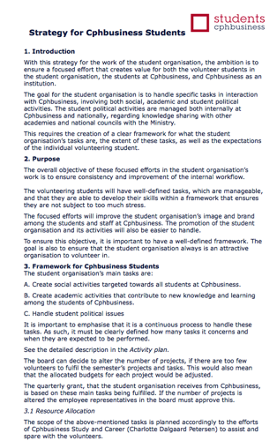
7. Strategy

Slide 12
7. Other topics?

Slide 13
8. Next Board meeting – date?

