Slide 1
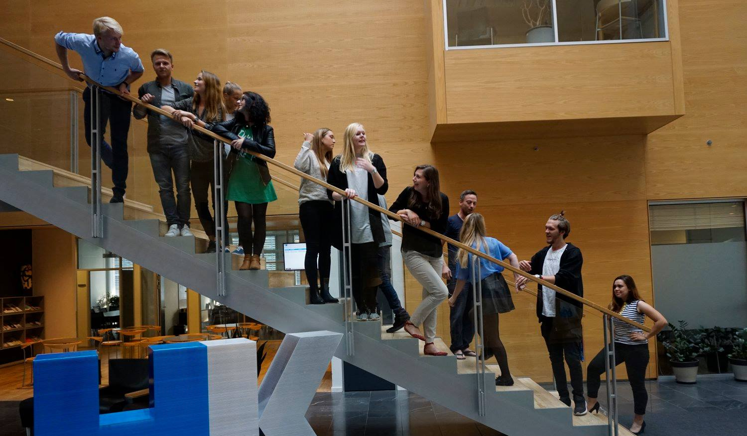
25th Board meeting
Cphbusiness Students
10 January 2018

Slide 2
Agenda
Approval of the agenda
Choice of minutes taker
Approval of the minutes (24th meeting)
Board members
Orientation
Financial situation
Other topics
Next meetings

Slide 3
1. Approval of the agenda

Slide 4
2. Choice of minutes taker

Slide 5
3. Approval of the minutes from the 24th board meeting

Slide 6
4. Board members
Cecilie stops in the student organisation
Vote off the board
1st alternate, Kimie Trillingsgaard
Vote in as ordinary board member
Roles:
Chairman - vote
Vice chairman - vote
Treasurer - vote
Secretary - vote

Slide 7
5. Orientation
Status on functions
HR – Kristian and Sophia
Finance – Kimie and Michella (Ida)
Communication - ?
Student political – Mariana
Bar Manager – Kevin and ?
Presidency – ?

Slide 8
5. Orientation
Student worker
Study and career (Cphbusiness) has been granted a student worker to support the student organisation together with Charlotte Dalgaard.
Next step: Charlotte creates job posting
Inputs?
Honours on graduation diplomas, 2018:
Frederik Ladehoff, Sebastian Holmegaard, Ana Bem Bizjan and Viktoria Kanyik.

Slide 9
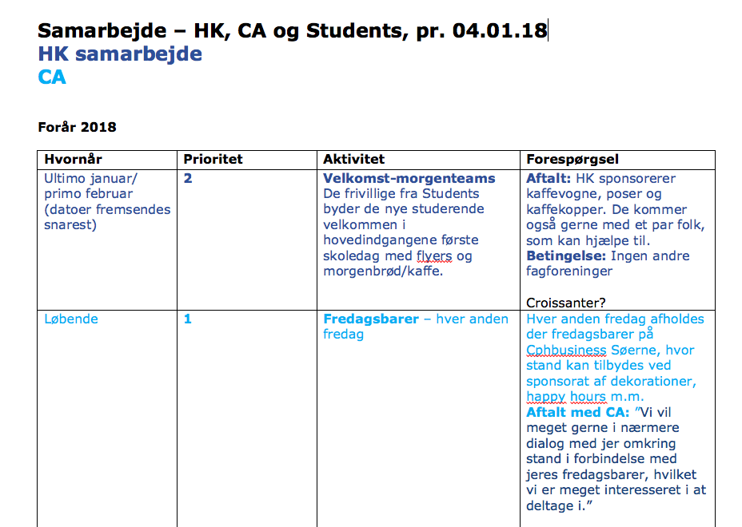
5. Orientation
Status on collaborations with HK and CA

Slide 10
5. Orientation
Status on systems
Website project is stranded. We lack knowledge of how to continue the website creation. Vilhelmine is contacted.
SharePoint to store documents, files etc.
Next step: Charlotte creates a folder
Moodle – status?

Slide 11
5. Orientation
Status on activities
Intro bars?
Morning welcome events
Who?
Intro presentations and video?
Introduction meeting?
3rd Status meeting incl. Finance course + social activity?

Slide 12
5. Orientation
Status on activities
Advisory Board meeting?
Friday bars (meeting with Studenterbolaget)?
Open house at Cphbusiness in February
Conference for all volunteers
Date?
Course?
Professional event in March?
Social event in April?

Slide 13
Month | Volunteer activities | Social activities | Professional activities | Student political activities | Promotion activities
January | Status meeting (+social activity) |  |  | Advisory Board meeting Students’ board meeting
February | Introduction meeting (for new volunteers) | Intro bars (4-5) Friday bars (1) |  |  | Intro presentation Open house presentation
March | Conference for volunteers Incl. Status meeting | Friday bars (2) | Event | Students’ board meeting
April | Status meeting | Friday bars (2) Event |  | Advisory Board meeting Cphbusiness’ board meeting
May | Status meeting | Friday bars (2) |  |  | Open house presentation
June | Celebration event for volunteers |  |  | Cphbusiness’ board meeting

Slide 14
5. Orientation
Meeting with Gregers 11/12-17
Discussion of the ongoing challenges
Formalities, board meetings, AGM, high volunteer turnover etc.
We need:
Better collaboration between chairmanship and Cphbusiness presidency
Better use of the student representatives in the school’s board of directors and better matching of expectations
Future concept for student activities

Slide 15
6. Financial situation v. Kimie
Current balance: + 26.863,15 DKK
Quarterly grant from Cphbusiness
19/12 Meeting with Mette Dietz
Mette works in Cphbusiness’ Economy department
Requests:
Dagrofa buying card
iPad for Friday bars
Flyers for morning teams
Cabel for camera

Slide 16
6. Financial situation
Current status of Bank account access:
Lujza Grossmanová, Sebastian Pilgaard, Kim Clement, Ida Sallerup Madsen
Kimie can not get access until the minutes from the 24 board meeeting has been signed.
Status on that?
Chairman and vice chairman can not get access until the minutes from this meeting has been signed by the board members.

Slide 17
7. Other topics?

Slide 18
8. Next Board meeting – date?

