Slide 1
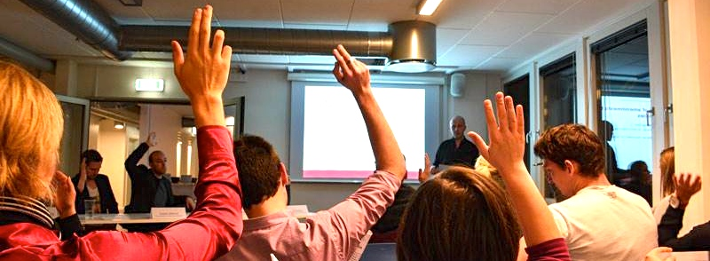
Welcome to
Cphbusiness Students
29.11.2017
PROGRAMME
17:00 Welcome
17:05 Annual General Meeting
Topics on the agenda:
- The boards’ report
- Approval of budget and financial overview
- Amendments to formalities
- Election of board members, alternates and auditor
19:00 Thank you for today

Slide 2
AGENDA
Election of moderator
Election of referent
The boards’ report
Budget and financial report
Auditors’ observations of the accounts
Approval of financial statements
Member topics
Approval of amendments to the formalities
Election of board members and alternates
Election of auditor(s)
Optional

Slide 3
1.
Election of moderator

Slide 4
2.
Election of referent

Slide 5
3. The boards’ report
Challenges - Chairmanship
February:
The chairman, Sebastian Pilgaard, resigned due to personal issues.
March:
New chairman, Kim Clement, and vice chairman, Ida Sallerup Madsen, were elected in March 2017.
There was a lack of knowledge sharing from the old chairman to the new chairmanship.
October:
Challenges with lack of teamwork between the chairman and vice chairman.
Kim, the chairman, resigned due to personal issues.
Ida, the vice chairman, resigns in January 2018 due to starting internship.

Slide 6
3. The boards’ report
Challenges - Chairmanship
October:
Rikke Boye was elected as the new chairman.
From January 2018: New chairmanship.
The board will constitute itself with a chairman and vice chairman.

Slide 7
3. The boards’ report
Challenges – Financial management
The Finance Manager (Sebastian Pilgaard) stopped in the student organisation before someone could take over.
Lack of login to economy systems
Lack of knowledge of financial management
Status:
The vice chairman, Ida, and the treasurer, Kimie, have worked hard to get an overview of the finances.
Login has been found and we work on getting a financial overview from February 2017 to June 2017.
Next step: Creating the financial report for the accountant.

Slide 8
3. The boards’ report
This summer: New strategy for the student organisation has been developed
Why:
To improve the organisation and its brand
Make it easier to be a volunteer – clearly defined framework
Create better activities for the students at Cphbusiness
Status:
We are still working on implementing the new structure of the organisation, BUT we have come a long way!

Slide 9
3. The boards’ report
Goodbye to old members and hello to new ones
Projects instead of departments
Projects manage themselves in every step
Functions instead of “Heads of department”
Manage the organisation and helps out the projects
Functions: HR, Finance, Student political, Communication, Presidency and Bar
Weekly workshops
Joint Status meetings for all volunteers

Slide 10
3. The boards’ report
What happened during the year?:
10 x Intro bars: 5 x Winter, 5 x Summer
2 x Intro events: Kick-off day & Party + Fælles i Fælled
21 x Friday bars
3 x Movie nights and Super Bowl Night
1 x Semester party (May)
1 x Roskilde Festival (32 participants)
3 x Pubcrawls
1 x Student political event: Debate bar with Søren Pind
5 x Board meetings
1 x Status meeting
3 x Advisory Board meetings
2 x Conference for volunteers
2 x Celebration Party for volunteers

Slide 11
3. The boards’ report
Friday bars:
Both bar managers will step down from January 2018. We are working on finding new bar managers
We moved the bar to Cphbusiness Søerne (September)
We added drinks (gin/tonic, gin/lemon and vodka/lemon) to the menu.
DJ Faustix played (sponsored)
The new mascot Flem Mingo → Very popular

Slide 12
3. The boards’ report
Events and activities - upcoming semester:
Intro event: Morning team → Planning process → We encourage people to help out
Intro presentations → Movie about the student organisation
One social event each semester
One professional event each semester
Friday bars: Every other Friday at Cphbusines Søerne
Board meetings (approx. 2)
Advisory Board meetings (approx. 2)
No Roskilde Festival and no semester party

Slide 13
4. Budget and financial statements
Budget: 1/7-17 to 30/6-18
Income | 2017/2018
iZettle, Friday bar income | 286.290
Ticket sale | 14.219
Contribution, Cphbusiness | 218.610
Roskilde Festival | 27.740
Sponsorships | 22.800
Income in Total | 541.919

Slide 14
Budget: 1/7-17 to 30/6-18
Expenses | 2017/2018
Fixed expenses (E-conomics, Spotify etc.) | 5.805
Studenterbolaget | 395.718
Roskilde Festival | 48.863
Events | 98.192
Promotion | 6.000
Meetings | 4.351
Various incl. fees | 1.212
Expenses in total | 560.141

Slide 15
Budget: 30/7-17 to 1/7-18
Result | 2017/2018
Income in total | 541.919
Expenses in total | 560.141
Result in total | - 18.222
Balance – ultimo June 2018 | + 2.157

Slide 16
4. Budget and financial statements
Budget: 1/7-17 to 30/6-18
Vote:
Approval of budget?

Slide 17
4. Budget and financial statements
Financial statements
The annual report from 1 July 2016 to 30 June 2017
Status:
Due to changes in the chairmanship and the lack of replacement of finance manager, it has not been possible to make the annual report.
Next step:
Kimie and Ida are working on creating the financial report for the accountant.
Help from professional advisor (paid by Cphbusiness)

Slide 18
5. Auditor’s observations of the accounts
Due to lack of the annual report, the auditor has not observed the accounts.
6. Approval of
financial statements
Due to lack of the annual report, no vote can be taken for the financial statements.

Slide 19
7. Members topics
Amendments to the articles of organisation

Slide 20
7.A. Approval of amendments to the formalities
Suggestion: § 2. Purpose
The student organisation’s purpose is to increase the study pleasure and well-being of all students at Cphbusiness, through student political, social and academic activities.
The organisation is non-political.
Approval?

Slide 21
7.A. Approval of amendments to the formalities
Suggestion: § 3. Membership
Members of the organisation are students at Cphbusiness.
Membership is free and students are not obligated, in any way, to make contributions towards the organisation.
Approval?

Slide 22
7.A. Approval of amendments to the formalities
Suggestion: § 4. Subsection 3
Candidates for positions on the board must be handed in to the chairman of the board no later than 7 days before the AGM. The candidates are announced to the students at Cphbusiness no later than 3 days before the meeting.
The moderator, the board members, the staff at Cphbusiness and invited guests have the right to speak at the AGM.
Approval?

Slide 23
7.A. Approval of amendments to the formalities
Suggestion: § 4. Subsection 6
Agenda
Election of moderator
Election of referent
The boards' report
Financial reporting, including auditors' observations of the accounts and approval of financial statements
Budget
Topics
Election of board members and alternates (1st, 2nd and 3rd alternate).
Election/appointment of auditor(s). If a state authorised accounting firm is not chosen as auditor of the organisation two auditors shall be elected.
Optional
Approval?

Slide 24
7.A. Approval of amendments to the formalities
Suggestion: § 4. Subsection 7
Proposals
All students at Cphbusiness may request points to be added to the agenda. These points must be sent to the board no later than 7 days before the AGM, so that they can be announced to the students at Cphbusiness no later than 3 days before the AGM.
Approval?

Slide 25
7.A. Approval of amendments to the formalities
Suggestion: Change “Subsection 9” and “Subsection 10” to “§5. Board of directors”
Suggestion: § 4. Board of directors
The board consists of 5 ordinary members elected at the AGM, 3 alternates elected at the AGM as well as 2 employees appointed by the president of Cphbusiness.
Approval of both suggestions?

Slide 26
7.A. Approval of amendments to the formalities
Suggestion: § 4. Board of directors
The ordinary members and the alternates must be students at Cphbusiness, and should be elected among the volunteers in the student organisation. The election should be based on experience within the student organisation and relevant skills. If possible, the alternates should be 1st or 2nd semester students. The alternates have the right to vote if an ordinary member is absent.
Approval?

Slide 27
7.A. Approval of amendments to the formalities
Suggestion: § 4. Board of directors
The employee representatives have the right to speak, but do not have voting rights at the board meetings.
Approval?

Slide 28
7.A. Approval of amendments to the formalities
Suggestion: § 4. Board of directors
The board works with the strategy and the daily tasks of the organisation and meets 4 times a year unless the board deems it necessary to meet more frequently.
Approval?

Slide 29
7.A. Approval of amendments to the formalities
Suggestion: § 4. Board of directors
The board is competent when at least 4 board members attend the board meetings. In case of less than 4 board members attending, absent board members may give their vote on topics in writing in advance of the meeting.
Approval?

Slide 30
7.A. Approval of amendments to the formalities
Suggestion: § 4. Board of directors
All volunteering students in the student organisation can participate in the board meetings.
In the event of elected board members' resignation from the board during the election period, the board may occupy vacant positions in the board, if necessary.
Approval?

Slide 31
7.A. Approval of amendments to the formalities
Suggestion: § 5. Subsection 2
Remove ”student councils” from the text.
Simplify the text.
“The organisation allows for committees to be established at all Cphbusiness departments, that have the purpose of creating activities for all students at Cphbusiness.
This can be in the form of a network or activity committees - the form is determined by the organisation's board of directors.”
Approval?

Slide 32
7.A. Approval of amendments to the formalities
Suggestion:
Delete § 6. Businesses and activities
Approval?

Slide 33
7.A. Approval of amendments to the formalities
Suggestion: §8. Subsection 2
The preparations are conducted together with the chairman and vice chairman.
At each board meeting, the treasurer presents the status of the student organisation’s finances.
Approval?

Slide 34
7.A. Approval of amendments to the formalities
Suggestion: §10. Subsection 2
Any proposals to amendment for these articles must be announced at least 7 days before the AGM.
Approval?

Slide 35
8. Election of
board members and alternates
5 board member and 3 alternates is needed
9 candidates for the board of directors:
Michella Bech: New volunteer in the organisation. Active in the student council in Lyngby
Kristian Akselsen: Volunteer since September 2017. Currently working as HR function in the organisation
Cecilie Rasmussen: Volunteer since September 2017. Currently working as Community manager (SoMe) and project leader of the morning team intro events.
Samuel Brask: New volunteer in the organisation. Interested in becoming vice chairman
Rikke Boye: Volunteer since September 2016. Currently working as SoMe coordinator and project leader of volunteer party. Board member since December 2016

Slide 36
8. Election of
board members and alternates
Candidates for the board:
Kimie Trillingsgaard: Volunteer since February 2017. Currently working as Finance Manager. Board member since October 2017.
Niclas Andersen: Volunteer since September 2017. Currently working as presidency coordinator. Board member since October 2017
Louise Ferre Sørensen: Volunteer since February 2017. Currently working as Bar Manager.
Anine Kjølbæk Sørensen: New volunteer in the organisation. Interested in becoming vice chairman.
Let’s vote!

Slide 37
8. Election of
board members and alternates
Let’s collect the voting paper

Slide 38
10. Break

Slide 39
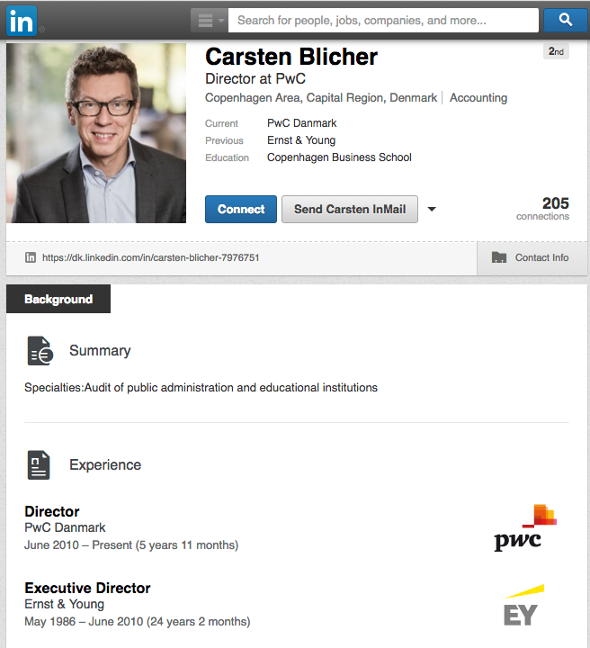
9. Election of auditor(s)
Suggestion:
Continue with the present accountant
Approval?

Slide 40
10. Optional

Slide 41
Keep up to date about
the student organisation

