Slide 1
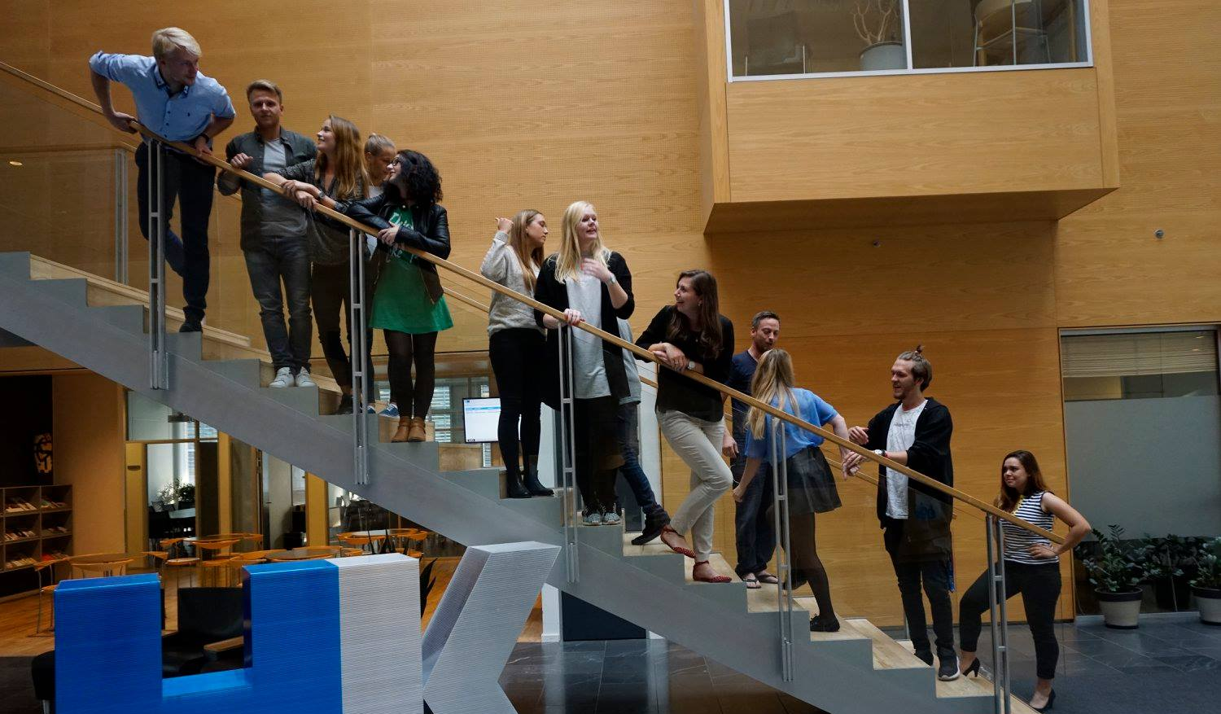
24th Board meeting
Cphbusiness Students
30 October 2017

Slide 2
Agenda
1. Approval of the agenda 2. Approval of the minutes (23rd meeting) 3. Orientation 4. Board members 5. Financial situation 6. Advisory Board meeting 7. Study start 8. Amendments to the formalities 9. Other topics 10. Next meetings

Slide 3
Approval of the agenda

Slide 4
Approval of the minutes from
the 23rd board meeting

Slide 5
Orientation
6/10 - Kim decided to stop as chairman/ president instantly.
Ida stops as vice president at the end of this semester
Both bar managers stop at the end of this semester
→ We are looking for new candidates
→ Today, we need to vote for a new chairman of the board.

Slide 6
Orientation
11/10 Conference was held. 15 participants.
Happening now:
New members are trained for the positions
Weekly workshops every Thursday
Recruitment for upcoming projects
Improvement of the Friday bars in collaboration with Studenterbolaget

Slide 7
Orientation
Study and career (Cphbusiness) has applied for a student worker to support the student organisation together with Charlotte Dalgaard. Status: waiting for response
Challenge: We lack access to Dinero, where the accounts are made. This means that we cannot present the annual report on the AGM.
Sebastian Pilgaard has the login info

Slide 8
Orientation
19/10, Kim made a contract with CA A-kasse.
Charlotte will make sure the contract is annulled due to:
The contract has not been approved by the board
The contract violates Cphbusiness’ rules about unions allowed on campus
Kim was not acting chairman, when he signed the contract (he resigned 6/10)

Slide 9
Orientation
Status on systems:
Website project is stranded. We lack knowledge of how to continue the website creation.
Google Drive and Plandate is closed due to lack of payments.
E-conomics: We still pay, because we cannot find login and extract information.

Slide 10
Board members
The following board members want to be voted off the board:
Bartlomiej Gozdek
Sebastian Pilgaard
Kim Clement
Thomas Christensen
Viktoria Kanyik
Vote

Slide 11
Board members
New candidates for the board:
Niclas Andersen
Kimie Trillingsgaard
Vote
At the upcoming AGM, new board members will be elected for 2018.

Slide 12
Board members - positions
The board needs a chairman, vice chairman, a treasurer and a secretary. We need:
A new chairman - candidates?
vote
A new treasurer - candidates?
vote
A new secretary for the board - candidates?
vote

Slide 13
Financial situation v. Ida
Current balance:
+3.251,45 DKK
Expected income: approx.+5.000 DKK
Out standing payments:
Deposits, Roskilde Festival 2017: 7.700 DKK
Outlays, approx. 1.500 DKK
Expected balance next week:
approx.-1.000 DKK

Slide 14
Financial situation
Current status of Bank account access:
Lujza Grossmanová
Sebastian Pilgaard
Kim Clement
Ida Sallerup Madsen
Ida is the only one, who is still active in the student organisation.

Slide 15
Financial situation
Suggestions for voting:
Lujza, Sebastian and Kim should no longer have access to the bank account
Vote
Kimie Trillingsgaard should have bank account access
Vote
(full names must be added to the minutes).

Slide 16
Financial situation
Current status:
Kim established a credit card for the bank account (without the board’s acceptance).
The credit card established by Kim Clement has been cancelled.
Suggestions for voting:
There should not be established a credit card for the student organisation
Vote

Slide 17
Financial situation
Types of Bank account access:
via online user agreement:
Lujza Grossmanová and Sebastian Pilgaard
via mandate
Kim Clement and Ida Sallerup Madsen
An online user agreement gives acces to all information on the bank account, but the person cannot establish a credit card on her/his own. It costs 100 DKK per year.
With a mandate agreement, the person does not have access to all payment info and can establish a credit card on their own.

Slide 18
Financial situation
Suggestion:
All bank account accesses should be established as online user agreements
Vote

Slide 19
Activities – the rest of 2017
31/10 + 2/11, Open house – Rikke does the presentations
31/10, 3rd Advisory Board meeting
7/11, 1st Status meeting from 17:00 - 19:00
AGM – must be held in November
Vote: 29/11 from 17:00 – 19:00
Celebration event for volunteers (2/12)
Friday bars (November – not December)

Slide 20
Activities
Next semester 2018

Slide 21
Month | Volunteer activities | Social activities | Professional activities | Student political activities | Promotion activities
January | Status meeting (+social activity) |  |  | Advisory Board meeting Students’ board meeting
February | Introduction meeting (for new volunteers) | Intro bars (4-5) Friday bars (1) |  |  | Intro presentation Open house presentation
March | Conference for volunteers Incl. Status meeting | Friday bars (2) | Event | Students’ board meeting
April | Status meeting | Friday bars (2) Event |  | Advisory Board meeting Cphbusiness’ board meeting
May | Status meeting | Friday bars (2) |  |  | Open house presentation
June | Celebration event for volunteers |  |  | Cphbusiness’ board meeting

Slide 22
Approval of activities
This means:
No Roskilde Festival this Summer
No Semester Party this Spring
Introduction meeting in February for recruitment of new volunteers
Friday Bar every other Friday (not every Friday)
Professional event in March
Social event in April

Slide 23
Advisory Board meeting
31/10 from 16:00 – 18:00
Topic(s) to be discussed - input?

Slide 24
Study start 2018 v. Cæcilie
No intro presentations
Welcome events
Intro bars

Slide 25
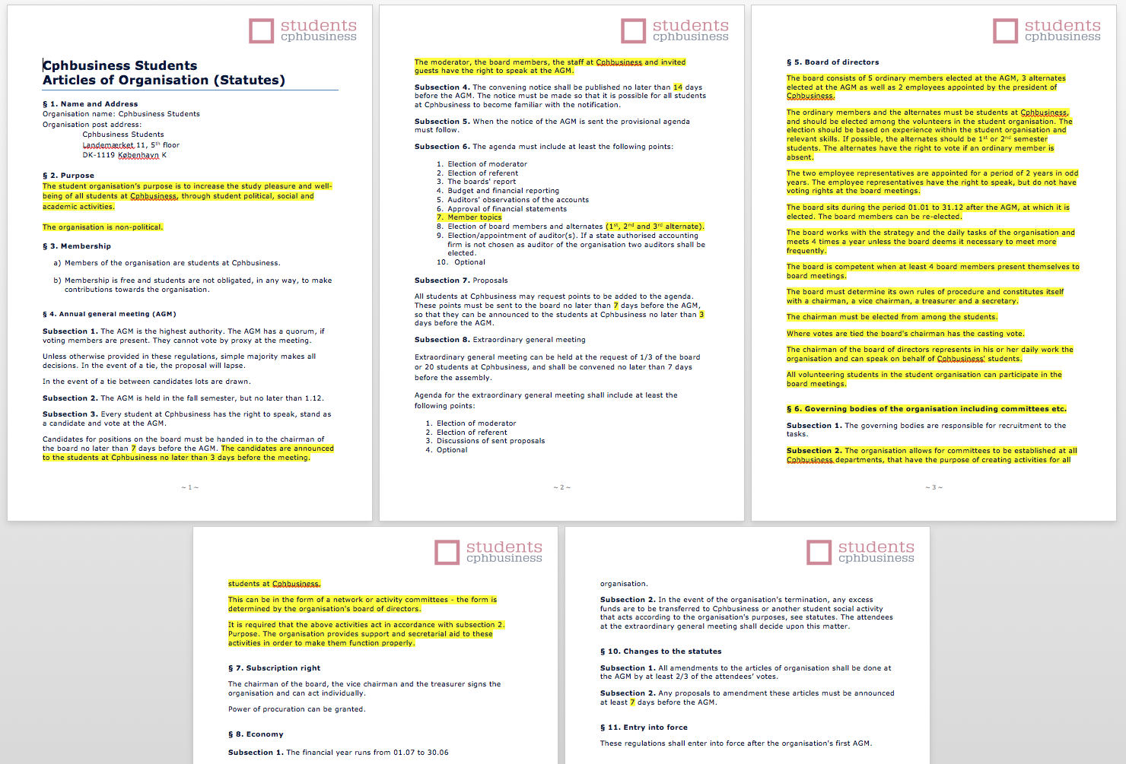
Amendments to the formalities
Suggestion: amendments to the formalities
Vote

Slide 26
Other topics?

Slide 27
Next Board meeting is in 2018

