Slide 1
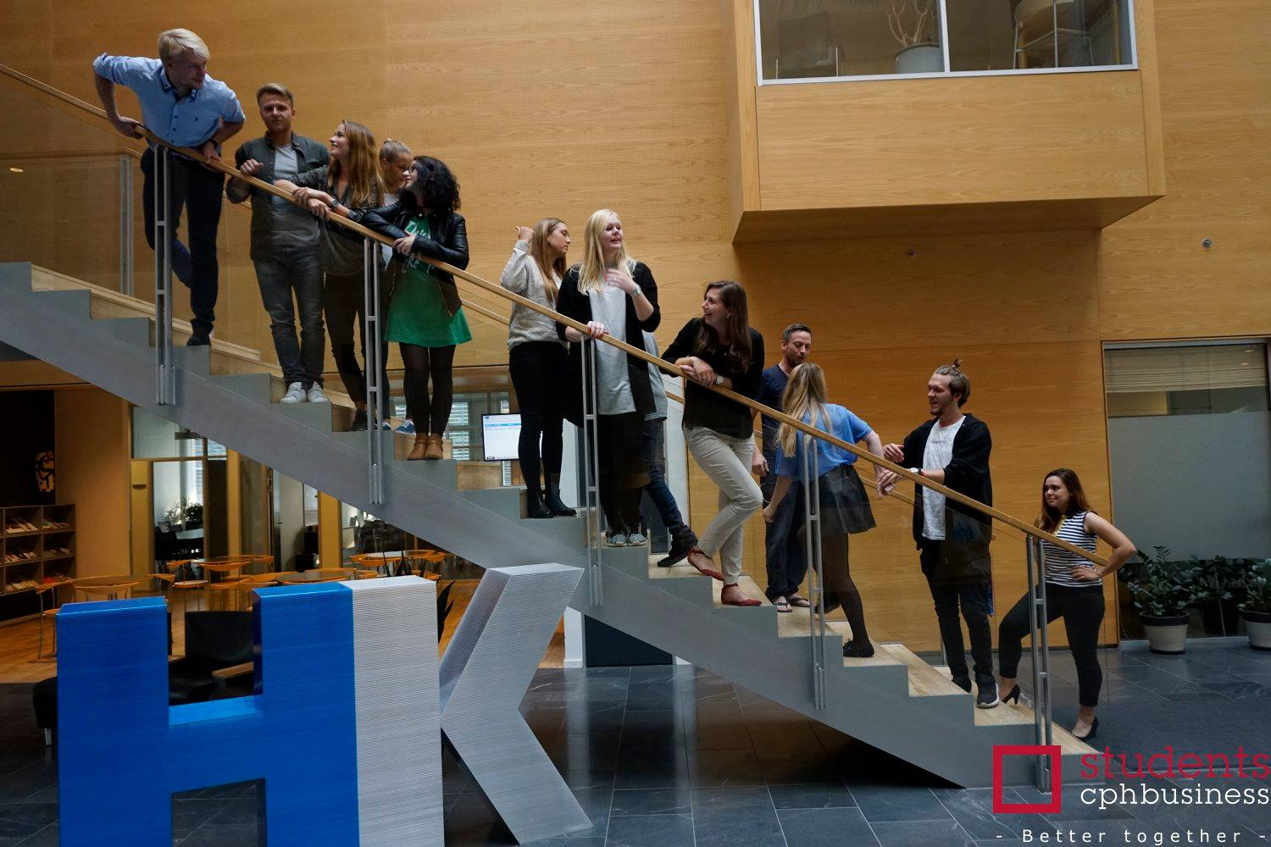
23rd meeting
Board of directors
3 May 2017

Slide 2
Agenda
Approval of the agenda
Approval of minutes
Orientation
Strategy status
Financial situation
Status – events
Study start
Other topics
Next meeting

Slide 3
Approval of agenda

Slide 4
Approval of minutes

Slide 5
Orientation / Kim
New Vice President
2nd Advisory board meeting
Student jobs within the student organisation

Slide 6
Strategy status
To do list:
Involve members
Plan development proces
Plan implementation
Vision?
Create overview of tasks and responsibilities (projects vs functions)
Create manuals
Create overview of members/volunteers/ helping staff (skills, contact info)

Slide 7
Strategy status
The strategy means..
Change of the formalities (must be approved at the Annual General Meeting in November)
Update of the info about the student organisation on the Cphbusiness website

Slide 8
Financial situation
Balance: +64.218,39
The financial year ends 30.06.17
Finance and our external accountant will make the annual accounts
The annual report will be presented at the Annual General Meeting in November

Slide 9
Status
Semester Party
Active Members Party
Roskilde Festival
Bar department

Slide 10
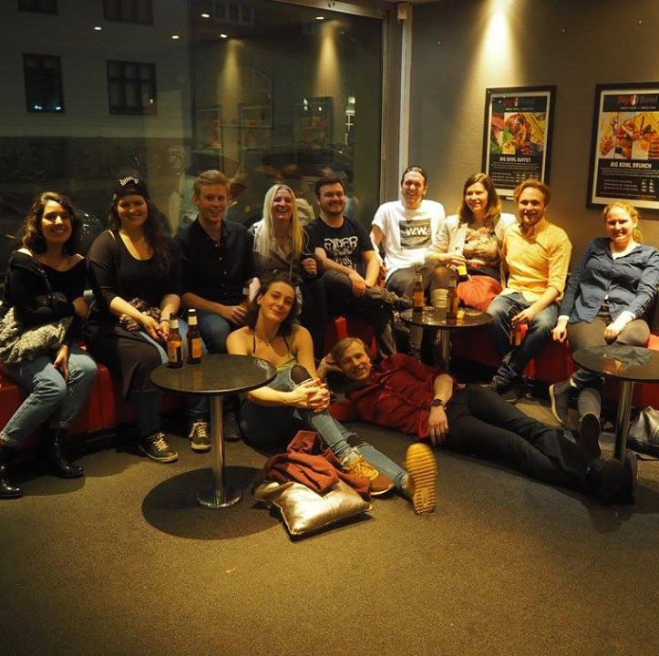
Study start / Frederik
Study start evaluation
Intro bars winter 2017
Intro weeks
Tutors
Intro tour 2017
Presentations in the intro week
28/8 – 8/9
Intro bars summer 2017
28/8 – 7/9
Intro event “Fælles i Fælled” 8/9

Slide 11
Other topics
Culture and vision / Viktoria
Picture database / Rikke
Exam training workshop / Charlotte

Slide 12
Next meeting:
Wednesday 7 June from 17-19

Slide 13
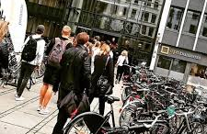
Keep updated on:
/cphbusinessstudents
@cphbusiness_students
Cphbusiness Søerne
Nansensgade 19
DK-1366 København K
Email: students@cphbusiness.dk

