Slide 1
16th Board meeting
14th of September 2016
- Better together -

Slide 2
Agenda
Approval of the agenda
Approval of the minutes from the last meeting
Future Summit
Orientation /Chairman
Evaluation of study start day /Charlotte
Financial situation /Head of Finance
Future of communication /Chairman
Kant Bar /Head of Business
Roskilde Festival – Evaluation /Chairman
Active members day /Chairman
Semester Party /Chairman
Other topics
Next meeting
- Better together -

Slide 3
1. Approval of agenda?
Can all approve the agenda for todays meeting!

Slide 4
2. Approval of minutes
from the last meeting?
Please sign the minutes from 15. board meeting.

Slide 5
3. Future summit

Slide 6
4. Orientation
/Chairman
Scheduling a meeting with possible Vice Chairman
Been in touch with planning team from future summit.

Slide 7
4. Orientation
/Chairman
Been to debat meeting on KEA.
De studernes råd

Slide 8
5. Evaluation of Study Start Day
/Charlotte
Overall experiences of the day
Around the table
Preparations
Volunteer recruitment
Room booking, janitors, canteens
Materials (programmes)
Fælles i Fælled - Overall experiences
Around the table
Study start in February
Must have: Presentation of Cphbusiness Students and study start packages
Suggestions?

Slide 9
6. The financial situation
/Head of finance
Balance 103.188,82 DKK
Accounts for AGM

Slide 10
7. Future of communication /Chairman on behalf of Head of communication
Future
Head of & 2nd Head of Communication will retire by 31 December 2016
Helene –
Support
Internship
KEA
Gabriella
Internship
Roskilde Festival
KEA

Slide 11
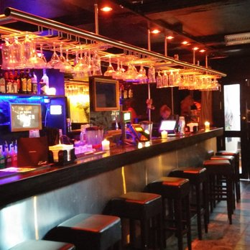
8. Kant Bar /Head of business

Slide 12
9. Roskilde Festival – Evaluation / Chairman
I Suggest we buy the sound box of the Camp group. The Price 3400DKK // Used in outdoor events and is portable.
That a agreed amount, of the RF16 goes to buying assets for RF 17.
Dinner for the Organazing team: Leo, Edwinas, Gabi and I.

Slide 13
10. Active Members Day
/ Chairman

Slide 14
10. Active Members Day /Chairman
Workshops?
Roskilde Festival 2017
Semester party 4/11
?
?
?

Slide 15
11. Semester Party - Budget /Chairman

Slide 16
12. Other topics
/Chairman
General meeting proposals
Before semesterparty 4/11
Tirsdag 1/11 kl. 16.30
Onsdag 2/11 kl. 16.30
Torsdag 3/11 kl. 16.30
After semesterparty 4/11
Tirsdag 8/11 kl. 16.30
Onsdag 9/11 kl. 16.30

Slide 17
12. Other topics
/Chairman
FC København tilbyder fri adgang til udvalgt kampe.
Bar department – Introbar at søerne
Please tell me a couple of days before if you have something for the board meetings.

Slide 18
Next meeting!
Wednesday 5/10 16:00-18:00
?
- Better together -

